Slide 1
Physical Control over Manufacturing Automation Systems in Digital Factories : hu ADMA 455 sp/22 ( Glenn Williams )
Josh Krug, Glenn Williams
Wednesday, 06/08/22 : 09.00 am – 09.30 am
Harrisburg, PA, USA

Slide 2
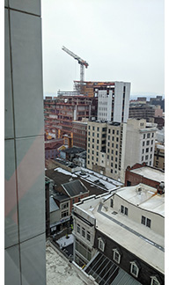
Physical Control over Manufacturing Automation Systems in Digital Factories : hu ADMA 455 sp/22 ( Glenn Williams )
Harrisburg University, Undergraduate ADMA 455-01-2022/Spring - Manufacturing Automation Systems ---------------------------------------------------------------------------------------------------------------------------------------------------

Slide 3
welcome and introductions ( Glenn Williams )
Joshua R. Krug
Solutions Engineer Phoenix Contact USA
EDUCATION: B.S. Electro-Mechanical Engineering Technology, Pennsylvania State University
Glenn P. Williams, P.E.
Lecturer in Advanced Manufacturing, AR & Robotics
EDUCATION: B.S. Mechanical Engineering, University of Vermont
EIT from Louisiana, PE from Ohio.

Slide 4
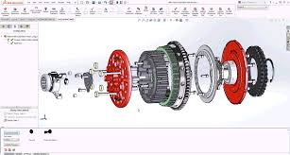
digital factory ( a working definition )
3D Part
3D Assembly
3D Model
Animation
Simulation
Control
Direction

Slide 5
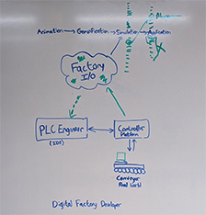
presentation ( Josh Krug and Glenn Williams )
OPENING STATEMENT : teaching doesn’t stop, even in a pandemic. ------------------------------------------------------------------------------------------------------------------------------------------------
slide 1 – classroom layout
slide 2 – bill of material selected
slide 3 – classroom notebook
slide 4 –plcnext control panel
slide 5 – factory I/O (software and purpose )
slide 6 – plcnext engineer (software and purpose )
slide 7 – Physical Control over Manufacturing Automation Systems in Digital Factories
slide 8 – digital factory [ classProject_SortThenWarehouse ] and plcNext controller [ AXC-F-2152 ]

Slide 6
presentation ( Josh Krug and Glenn Williams )
slide 1 of 6 - classroom layout ------------------------------------------------------------------------------------------------------------------------------------------------

Slide 7
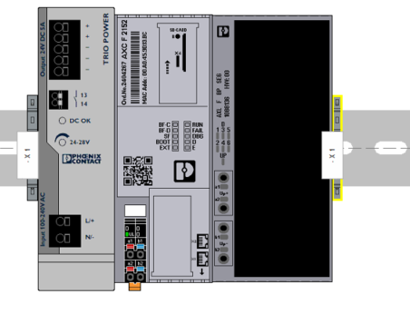
presentation ( Josh Krug and Glenn Williams )
slide 2 of 6 – bill of material selected ------------------------------------------------------------------------------------------------------------------------------------------------
Part Number |  | Type | Manufacturer | Comments
2404267 |  | AXC F 2152 | Phoenix Contact | Controller
0801377 |  | NS 35/ 7,5 V2A UNPERF 2000MM | Phoenix Contact | DIN Rail, unperforated
2903148 |  | TRIO-PS-2G/1AC/24DC/5 | Phoenix Contact | Primary-switched TRIO POWER power supply
1088136 |  | AXL F BP SE6 | Phoenix Contact | AxiolineSE, Base Module, 6 positions
1088104 |  | AXL SE AI4 U 0-10 | Phoenix Contact | Axioline SE, Analog Input module for 0-10 VDC
1088123 |  | AXL SE AO4 I 4-20 | Phoenix Contact | Axioline SE, Analog Output module for 4-20ma
1088129 |  | AXL SE DO16/1 | Phoenix Contact | Axioline SE, 16 Digital Outputs
1088134 |  | AXL SE SC-A | Phoenix Contact | Axioline SE SC-A
1088127 |  | AXL SE DI16/1 | Phoenix Contact | Axioline SE, 16 Digital Inputs
1078999 |  | PTV 2,5-QUATTRO | Phoenix Contact | Feed-through Terminal Block
1079006 |  | PTV 2,5-QUATTRO BU | Phoenix Contact | Feed-through Modular Terminal Block
3022276 |  | CLIPFIX 35-5 | Phoenix Contact | End clamp
1020042 |  | TMC 71D 06A | Phoenix Contact | Thermomagnetic Device Circuit Breaker
1088748 |  | D-PTV 2, 5/4-QUATTRO | Phoenix Contact | End Cover

Slide 8
presentation ( Josh Krug and Glenn Williams )
slide 3 of 6 – classroom notebook ( plcnext control platform / plcnext engineer / factory io) ------------------------------------------------------------------------------------------------------------------------------------------------
PLCnext Control start guide
PLCnext Engineer manual
BOM spreadsheet
PLCnext Technology
Factory I/O online manual
YouTube training clips

Slide 9
presentation ( Josh Krug and Glenn Williams )
slide 4 of 6 – plcnext control panel ( hardware and purpose ) ------------------------------------------------------------------------------------------------------------------------------------------------

Slide 10
presentation ( Josh Krug and Glenn Williams )
slide 5 of 6 – factory I/O ( software and purpose ) ------------------------------------------------------------------------------------------------------------------------------------------------

Slide 11
presentation ( Josh Krug and Glenn Williams )
slide 6 of 6 – plcnext engineer (software and purpose ) ------------------------------------------------------------------------------------------------------------------------------------------------

Slide 12
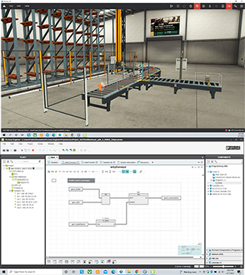
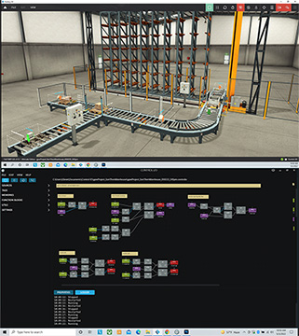
presentation ( Josh Krug and Glenn Williams )
slide 7 of 8 – Physical Control over Manufacturing Automation Systems in Digital Factories ------------------------------------------------------------------------------------------------------------------------------------------------

Slide 13
presentation ( Josh Krug and Glenn Williams )
slide 8 of 8 – digital factory [ classProject_SortThenWarehouse ] and plcNext controller [ AXC-F-2152 ] ------------------------------------------------------------------------------------------------------------------------------------------------

Slide 14
thank you ( from all of us - HU, PxC and EduNet )
FYI everyone - on the horizon: “ HU Case Study [ Number 1 ] “
------------------------------------------------------------------------------------------
Student interns are working on case study [ number 1 ]: digital factory [ classProject SortThenWarehouse ] and plcNext controller [ AXC-F-2152 ]
www.harrisburgu.edu

