Slide 1
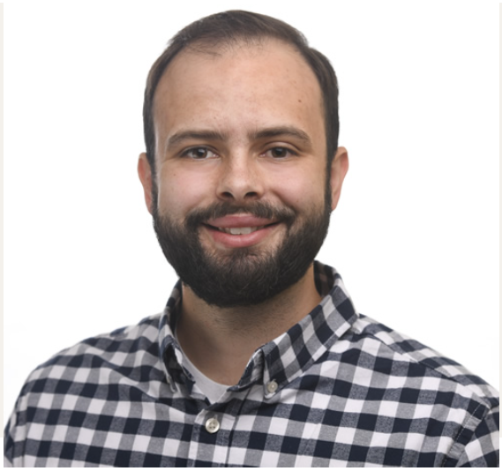
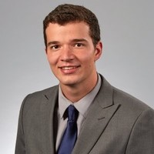
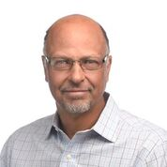
HU Aquaponics Monitoring and Control System : HU AqMCS 2022 ( Glenn Williams )
Joseph Tetreault, Josh Krug, Glenn Williams
Wednesday, 06/08/22 : 08.00 am – 08.30 am
Harrisburg, PA, USA

Slide 2
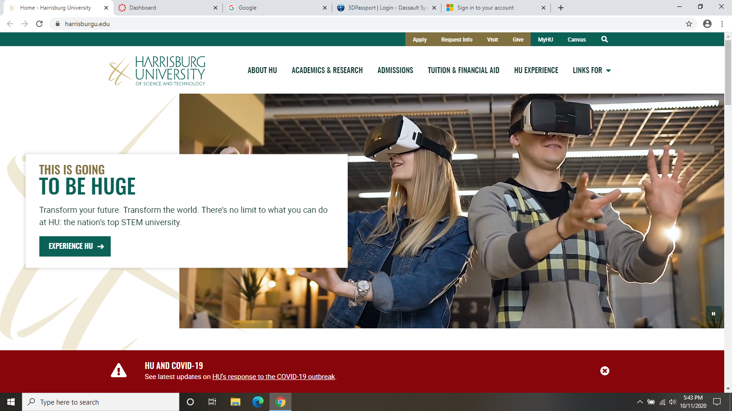
HU Aquaponics Monitoring and Control System
: HU AqMCS 2022 ( Glenn Williams )
Harrisburg University Presidential Research Grant 2019 / 2020; Ongoing Research 2021 / 2022
---------------------------------------------------------------------------------------------------------------------------------------------------
“The project involves the design and implementation of technology that will regularly take measurements from the environment (e.g., air temperature, water temperature, pH, dissolved oxygen, etc.).
PLCnext Technology will systematically collect, store, and web-publish the measurement data for HU researchers, scientist and the public to use for scientific research.”
Accepted and Approved : --------------------------------
Dr. Eric Darr, Ph.D. President Harrisburg University of Science and Technology Harrisburg , PA 17101, USA
www.harrisburgu.edu

Slide 3
welcome and introductions ( Glenn Williams )
Joseph Tetreault, M.S.
Research Scientist: Controlled Environment Agriculture
EDUCATION: B.S. Natural Sciences, Lyndon State College
M.S. Agricultural Sciences University of New Hampshire
Joshua R. Krug
Solutions Engineer Phoenix Contact USA
EDUCATION: B.S. Electro-Mechanical Engineering Technology, Pennsylvania State University
Glenn P. Williams, P.E.
Lecturer in Advanced Manufacturing, AR & Robotics
EDUCATION: B.S. Mechanical Engineering, University of Vermont
EIT from Louisiana, PE from Ohio.

Slide 4
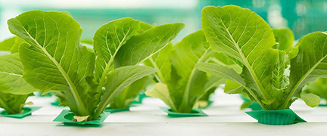
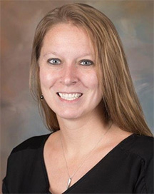
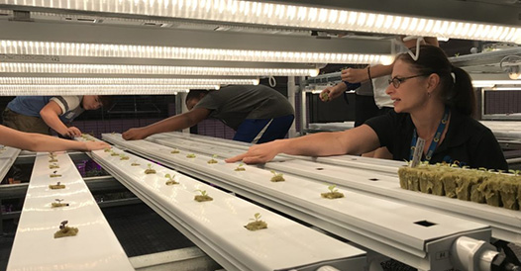
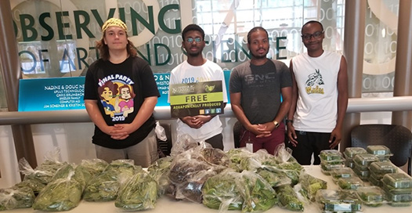
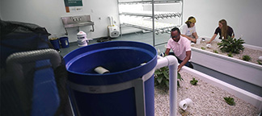
hu su aquaponics lab ( Rachel Fogle, Ph.D. )
Even though it has existed for centuries, aquaponics, or the combination of raising fish and growing plants together in water, has only in recent years grown in popularity as society continues to move toward more locally produced food and vegetation.
In aquaponics, fish waste provides an organic food source for plants, and plants naturally filter water for fish.
Many people today view aquaponics as a more sustainable and environmentally conscious form of raising food and plants.

Slide 5
presentation 1 ( Joseph Tetreault )
OPENING STATEMENT : learning doesn’t stop, even in a pandemic.
---------------------------------------------------------------------------------------------------------------------------------------------------
slide 1 - Emerging Aquaponics Market - CEA (controlled environment agriculture )
slide 2 - Emerging Aquaponics Market - Expanding CEA
slide 3 - Expanding Aquaponics at Harrisburg University - HU AqMCS
slide 4 - Expanding Aquaponics at Harrisburg University - Automation Research Goals
slide 5 - Interdisciplinary Collaboration Opportunities with and within HU - Collaboration
slide 6 - Interdisciplinary Collaboration Opportunities with and within HU - Commercial-scaled Research

Slide 6
presentation 1 ( Joseph Tetreault )
slide 1 of 6 - Emerging Aquaponics Market - CEA
---------------------------------------------------------------------------------------------------------------------------------------------------
Aquaponics is an emerging controlled environment agriculture (CEA) technology
Combines established practices of recirculating aquaculture and hydroponic plant production
Current research to combine two separate agricultural systems
Benefits include water conservation, year-round fresh food production, elimination of food deserts

Slide 7
presentation 1 ( Joseph Tetreault )
slide 2 of 6 - Emerging Aquaponics Market - Expanding CEA
---------------------------------------------------------------------------------------------------------------------------------------------------
Expanding CEA market
Increased urbanization and loss of arable land
Recirculating aquaculture up 5.8% over past decade per FAO 2018 Report
Food security concerns resulting from pandemic

Slide 8
presentation 1 ( Joseph Tetreault )
slide 3 of 6 - Expanding Aquaponics at Harrisburg University - HU AqMCS
---------------------------------------------------------------------------------------------------------------------------------------------------
Current lab-scaled system with on-going construction for commercial-scaled system
STEM education for students
Experiential learning opportunities for CEA careers
Research with industry partners

Slide 9
presentation 1 ( Joseph Tetreault )
slide 4 of 6 - Expanding Aquaponics at Harrisburg University – Automation Research Goals
---------------------------------------------------------------------------------------------------------------------------------------------------
Automation research goals
Sensor applications to manage water quality, maintain plant and animal health, and control environmental conditions
Allow for improved growth rates for increased revenue

Slide 10
presentation 1 ( Joseph Tetreault )
slide 5 of 6 - Interdisciplinary Collaboration Opportunities with and within HU - Collaboration
---------------------------------------------------------------------------------------------------------------------------------------------------
Combination of Advanced Manufacturing and CEA faculty and scientist
Experts in the automation and agricultural sciences
Foundation of lab-scaled research
Completed and on-going research to develop new technologies

Slide 11
presentation 1 ( Joseph Tetreault )
slide 6 of 6 - Interdisciplinary Collaboration Opportunities with and within HU - Commercial-scaled Research
---------------------------------------------------------------------------------------------------------------------------------------------------
Expanding to commercial-scaled research for industry impact
Opportunity to beta test developed technologies and research in “real world” scenarios
Ensure success before approaching the open market

Slide 12
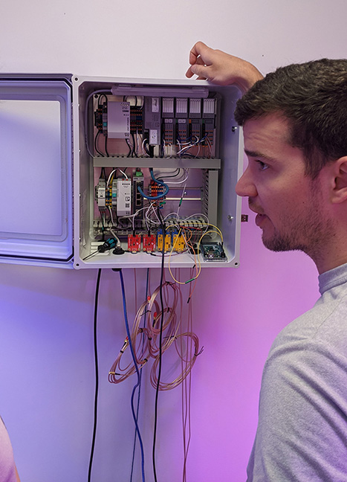
presentation 2 ( Josh Krug )
OPENING STATEMENT : Discussion on technical details about the system monitoring the aquaponics lab.
---------------------------------------------------------------------------------------------------------------------------------------------------
slide 1 - Technical Details - Overview
slide 2 - Technical Details - Hardware
slide 3 - Technical Details - Software
slide 4 - Technical Next Steps - HU AqMCS
slide 5 - Comments / Observations / Thoughts - Reflections
Phoenix Contact | Harrisburg University – EduNet 2022

Slide 13
presentation 2 ( Josh Krug )
slide 1 of 5 - Technical Details - Overview
---------------------------------------------------------------------------------------------------------------------------------------------------
Training
In-person
Online
Support
Hardware specification
Programming
Debugging
Examples
Programming
Visualization (HMI) development
Overview | Harrisburg University

Slide 14
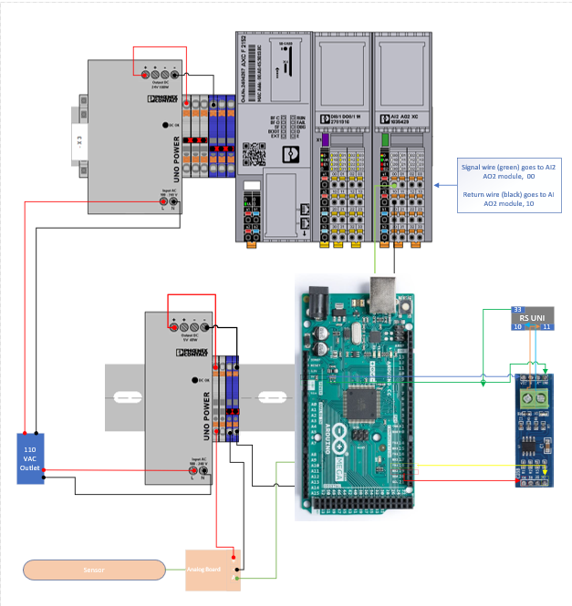
presentation 2 ( Josh Krug )
slide 2 of 5 - Technical Details - Hardware
--------------------------------------------------------------------------------
Main Components
PLCnext Controller - AXC F 2152
Arduino
AXL F I/O modules
Analog Inputs
Digital Inputs/Outputs
Thermocouple Inputs
Sensors
Ph, Temperature, Dissolved Oxygen and more
Power
5 VDC – Powers Arduino & sensor hardware
24 VDC – Powers control system hardware

Slide 15
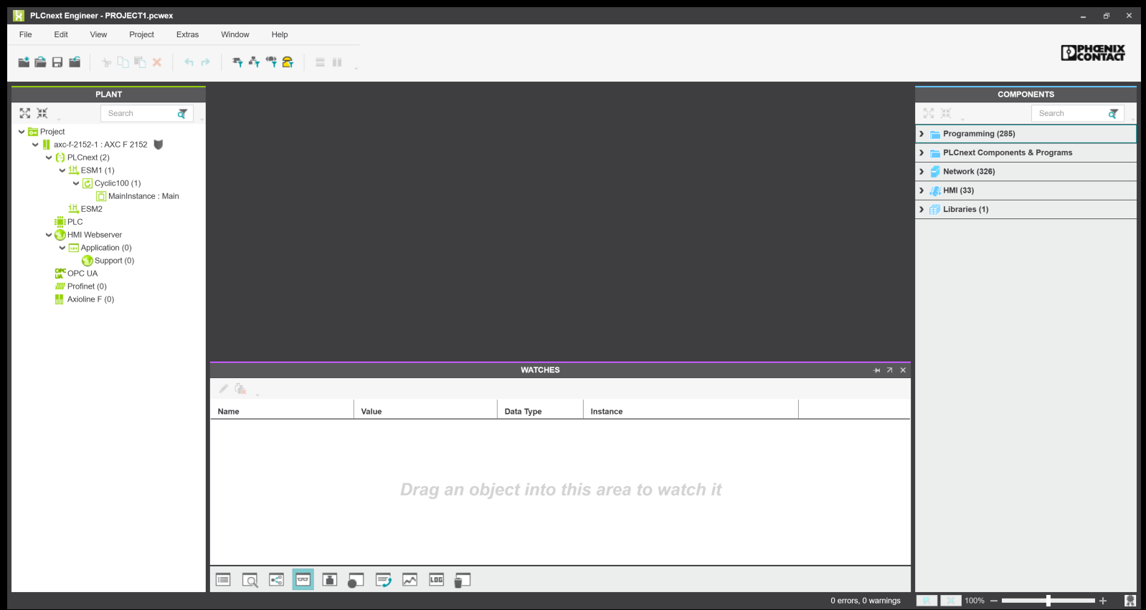
presentation 2 ( Josh Krug )
slide 3 of 5 - Technical Details - Software
---------------------------------------------------------------------------
PLCnext Engineer
Programming Language Used : IEC611-31
HMI Development
Arduino IDE
sensor data collection
Linux
Openness allowed for installation of a Domain Name Server client for remote access to a webpage.
Database
Using the native mySQL database on the controller allows for simple data collection.
The database can offer local access for other services to use the data for analytics

Slide 16
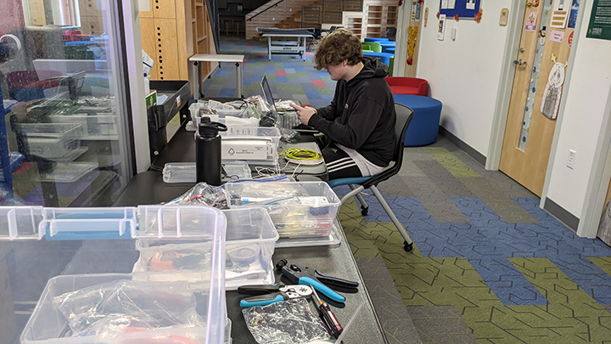
slide 4 of 5 - Technical Next Steps
presentation 2 ( Josh Krug )
Last Year
Continue testing and setting up new sensors
Finalize the visualization (HMI)
Gather complete Bill of Materials (BOM)
Design the control cabinet for hardware
Allow for expansion to add control functionality
in the future
Build out the cabinet
Install the system
Test the system
This Year
Finalize code for existing sensors
Continue HMI Development
Continue testing system
Next Steps | Harrisburg University

Slide 17
presentation 2 ( Josh Krug )
slide 5 of 5 - Reflections
---------------------------------------------------------------------------------------------------------------------------------------------------
Harrisburg University continues to stay engaged with the technology used for the monitoring system. They take great initiative in setting up meetings to ensure the project continues to move forward.
Technical challenges:
Finding industrial sensors to work with industrial hardware.
Figuring out how to design a solution to be both educational and functional.
Busy schedules create challenges for exchanging ideas and knowledge
Reflections | Harrisburg University

Slide 18
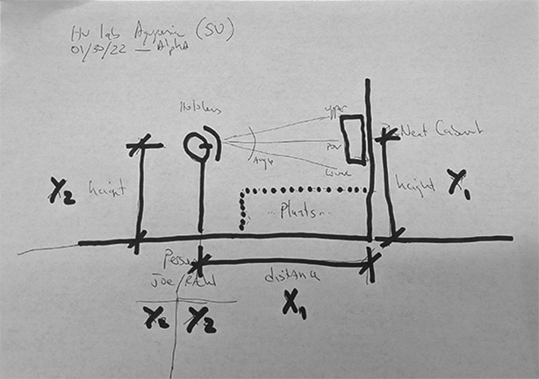
presentation 3 ( Glenn Williams )
OPENING STATEMENT : teaching doesn’t stop, even in a pandemic. ------------------------------------------------------------------------------------------------------------------------------------------------
slide 1 - HU student lab layout ( beta 2 - placement of 10 sensors )
slide 2 - dashboard design ( beta 2 - monitoring 10 sensors )
slide 3 - naming convention ( 5 types; 10 instances - 2 per type )
slide 4 - main program variables list ( example )
slide 5 - main code coding ( example )
slide 6 - function Ph sensor coding ( example )
slide 7 - dashboard beta 2 HMI page ( example )
slide 8 - holoLens remote access ( example )

Slide 19
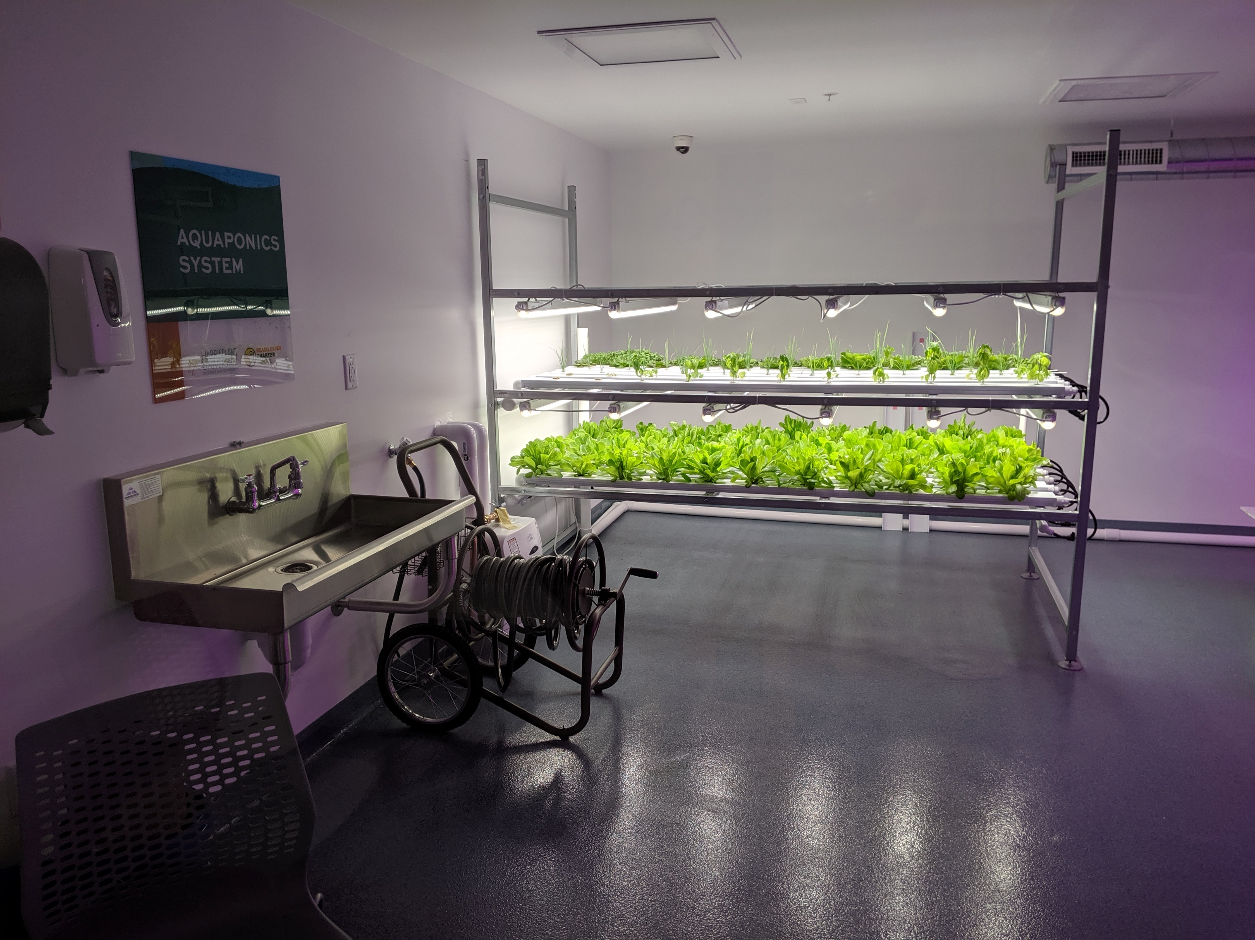
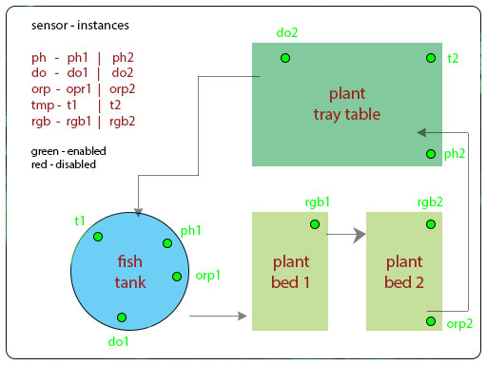
presentation 3 ( Glenn Williams )
slide 1 of 6 - HU student lab layout ( beta 2 - placement of 10 sensors ) ------------------------------------------------------------------------------------------------------------------------------------------------

Slide 20
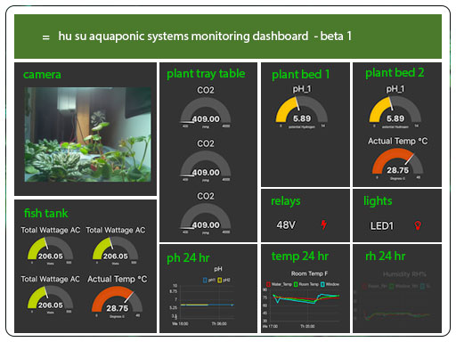
presentation 3 ( Glenn Williams )
slide 2 of 6 – dashboard design ( beta 2 - monitoring 10 sensors ) ------------------------------------------------------------------------------------------------------------------------------------------------

Slide 21
presentation 3 ( Glenn Williams )
slide 3 of 6 – sensor naming convention ( 5 types; 10 instances - 2 per type ) ------------------------------------------------------------------------------------------------------------------------------------------------
Naming Convention: by Sensor Type
index: sensor Type ( actual ): Sensor ID ( instance ): Sensor Location ( hu su lab ):
01 pH ( Analog pH Sensor / Meter ) ph1 fish tank
02 pH ( Analog pH Sensor / Meter ) ph2 plant tray table
03 DO ( Analog Dissolved Oxygen Meter ) do1 fish tank
04 DO ( Analog Dissolved Oxygen Meter ) do2 plant tray table
05 T ( Temperature Kit ) t1 fish tank
06 T ( Temperature Kit ) t2 plant tray table
07 ORP ( Analog ORP Sensor / Meter ) orp1 fish tank
08 ORP ( Analog ORP Sensor / Meter ) orp2 plant bed 2
09 RGB ( Embedded Color Sensor ) rgb1 plant bed 1
10 RGB (Embedded Color Sensor ) rgb2 plant bed 2

Slide 22
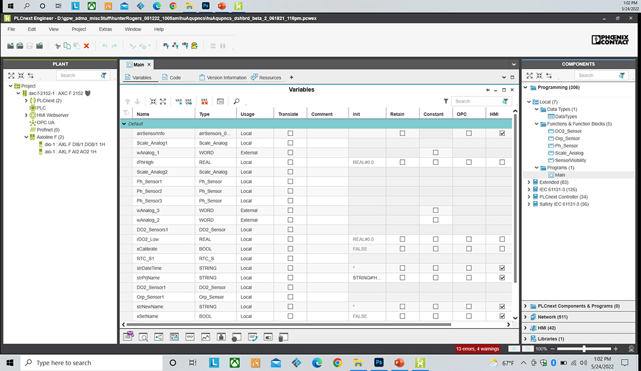
presentation 3 ( Glenn Williams )
slide 4 of 6 – main program variables list ( example ) ------------------------------------------------------------------------------------------------------------------------------------------------

Slide 23
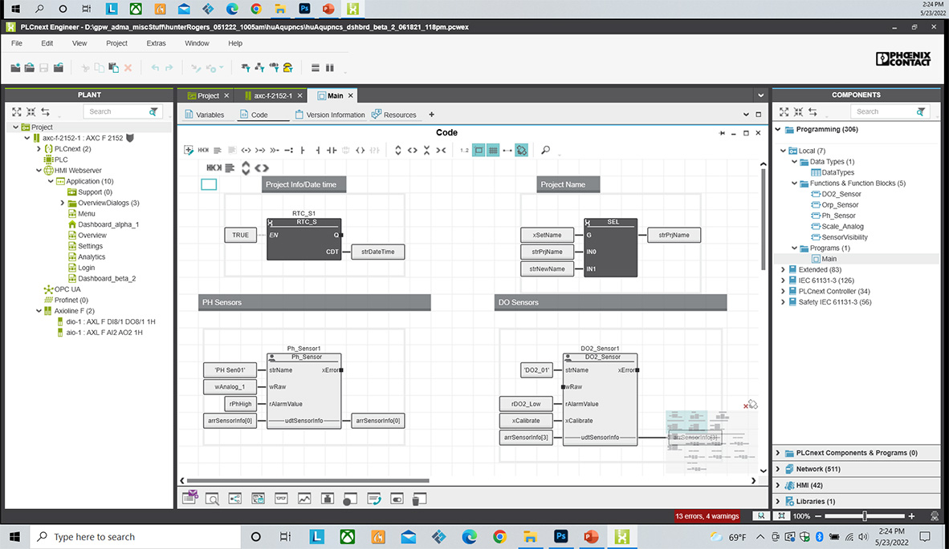
presentation 3 ( Glenn Williams )
slide 5 of 6 – main code LD coding ( example ) ------------------------------------------------------------------------------------------------------------------------------------------------

Slide 24
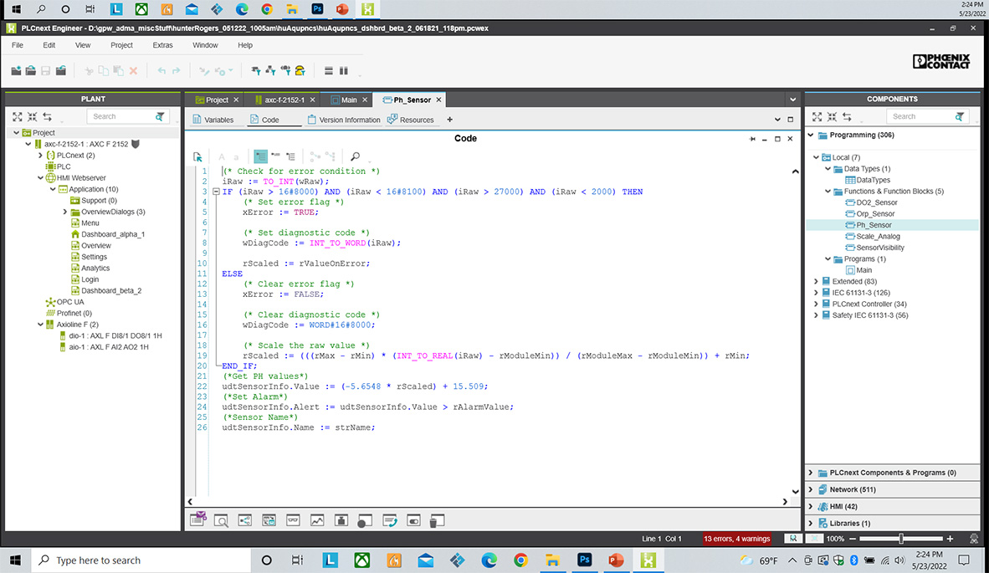
presentation 3 ( Glenn Williams )
slide 6 of 6 – function Ph sensor ST coding ( example ) ------------------------------------------------------------------------------------------------------------------------------------------------

Slide 25
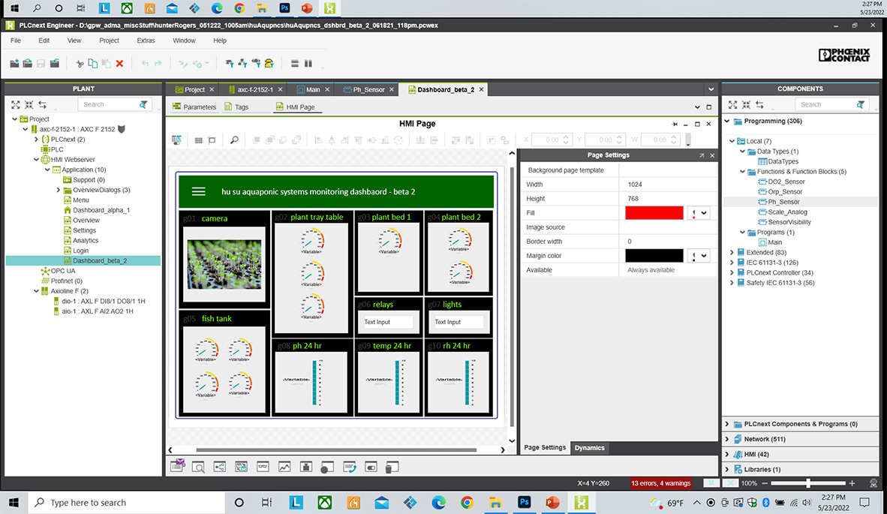
presentation 3 ( Glenn Williams )
slide 7 of 8 – dashboard beta 2 HMI page ( example ) ------------------------------------------------------------------------------------------------------------------------------------------------

Slide 26
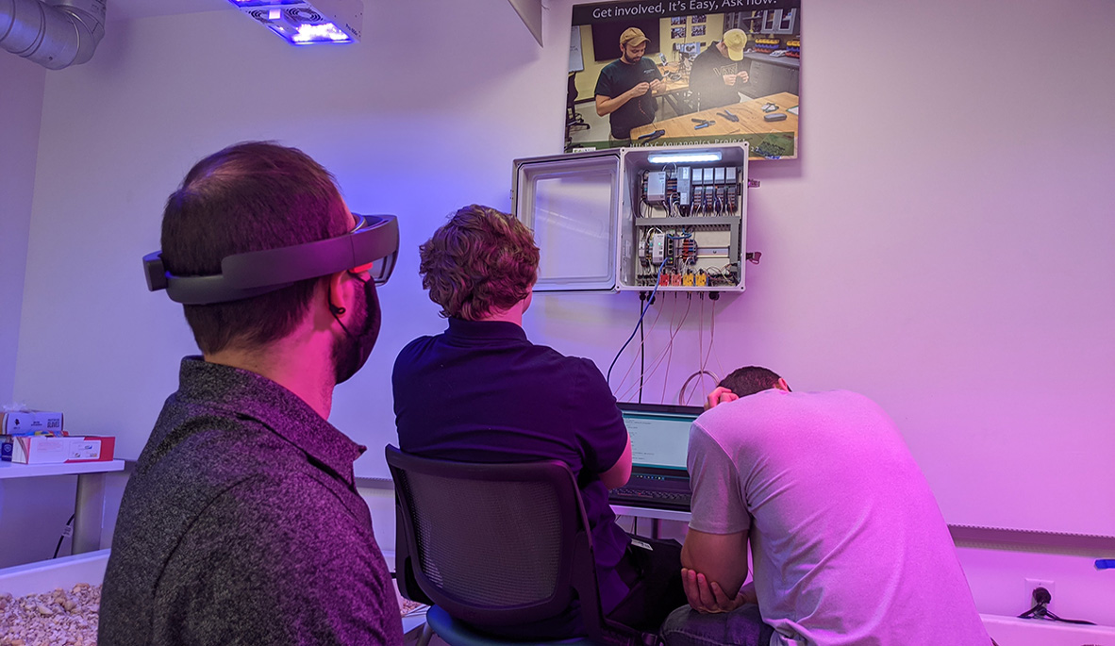
presentation 3 ( Glenn Williams )
slide 8 of 8 –HoloLens remote access ( example ) ------------------------------------------------------------------------------------------------------------------------------------------------

Slide 27
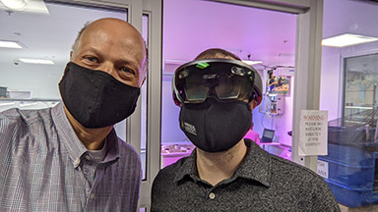
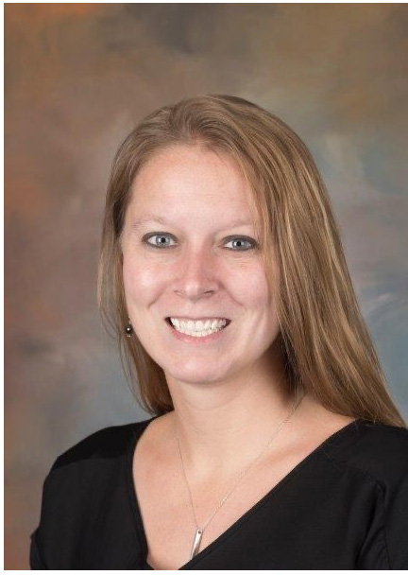
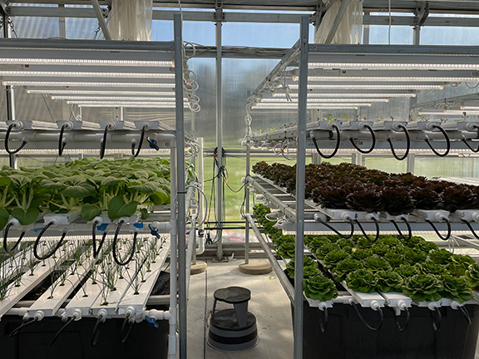
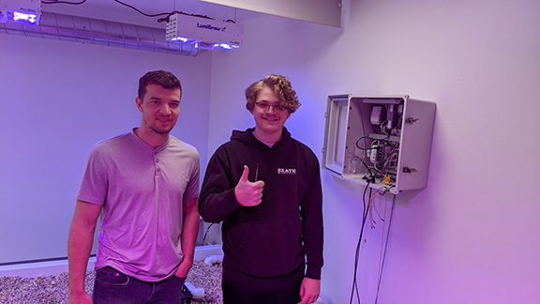
thank you ( from all of us - HU, PxC and EduNet )
FYI everyone - on the horizon: “ HU’s Steelton Aquaponics Lab “
------------------------------------------------------------------------------------------
we are at a point where we can describe the plcNext Control Platform:
controller, IO modules, Arduino, signal conditioners, buttons, switches, sensors.
www.harrisburgu.edu

