Slide 1
Accessibility Center of Excellence
Global Accessibility Awareness Day (GAAD) 2022
What You Can Do
May 19, 2022
Notes:
Hi everybody!
We’ve talked about what other people and organizations are doing.
Now I’d like to talk about things that you can do…

Slide 2
What type of content should be accessible?
Most people think:
Customer-facing only
Websites
Applications
Mobile Apps
Captions for videos
They forget about:
Employee-facing
Email
Documents
Audio descriptions, transcripts for videos
Live captions and transcripts for meetings
Notes:
Most people think that accessibility is somebody else’s job.
Some think it’s all IT’s responsibility.
The truth is: it’s everybody’s responsibility.
It’s just understanding what all is impacted.

Slide 3
What’s one thing you can do?
Use the accessibility checker!
The accessibility checker is on the Review ribbon, next to spell check in Microsoft products.
Notes:
I’m showing an example of the Review tab from Outlook, PowerPoint and Word.

Slide 4
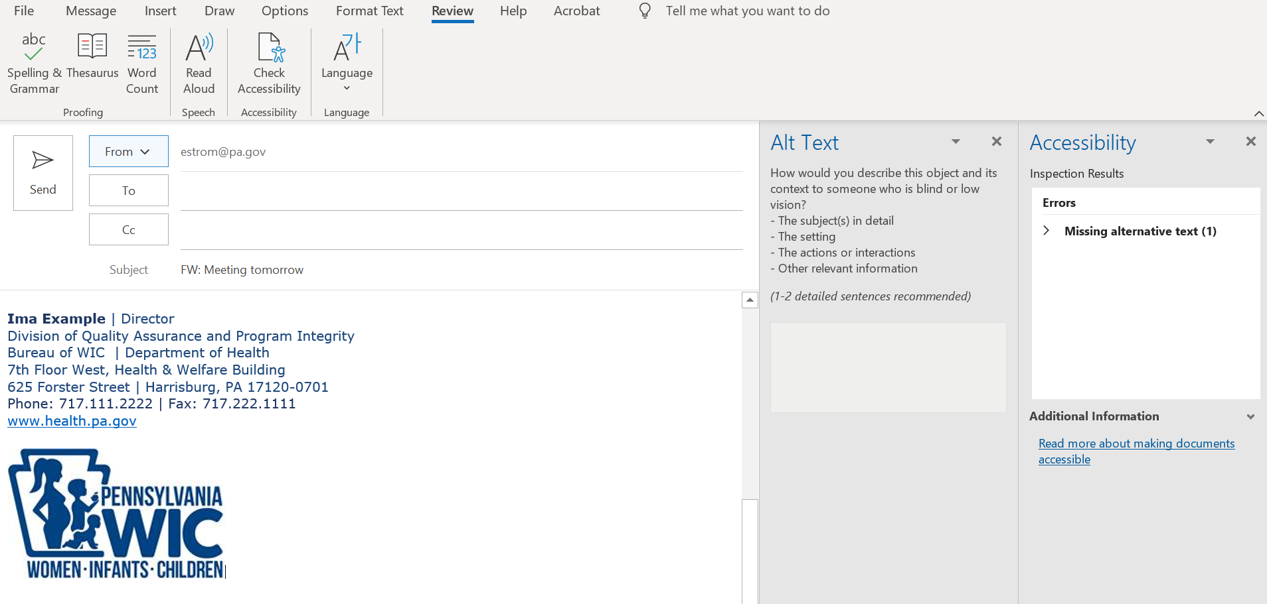
Email Example 1: Accessibility error found
The Accessibility (A11y) Checker provides a list of the errors found.
Notes:
The first example I’m going to show you is from Outlook.
When you run the accessibility checker, you’ll see a list of errors.
In this case, there’s only one in the signature.

Slide 5
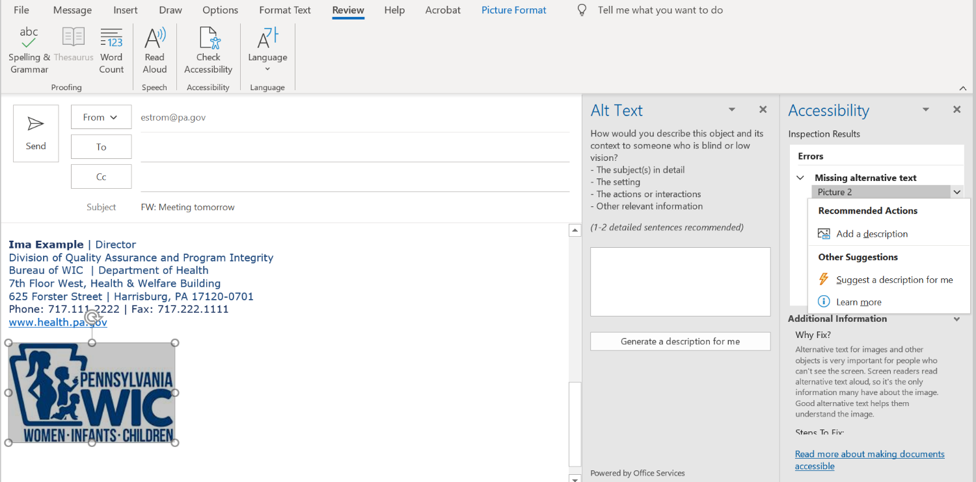
Email Example 1: Expand information
When you expand the error, you get:
The option to add a description.
Information on why and how to fix the error
Notes:
When you expand the error, you see:
Recommended actions: add a description
Other suggestions: Suggest a description for me.
Learn more
Additional information:
Why Fix
Steps to fix

Slide 6
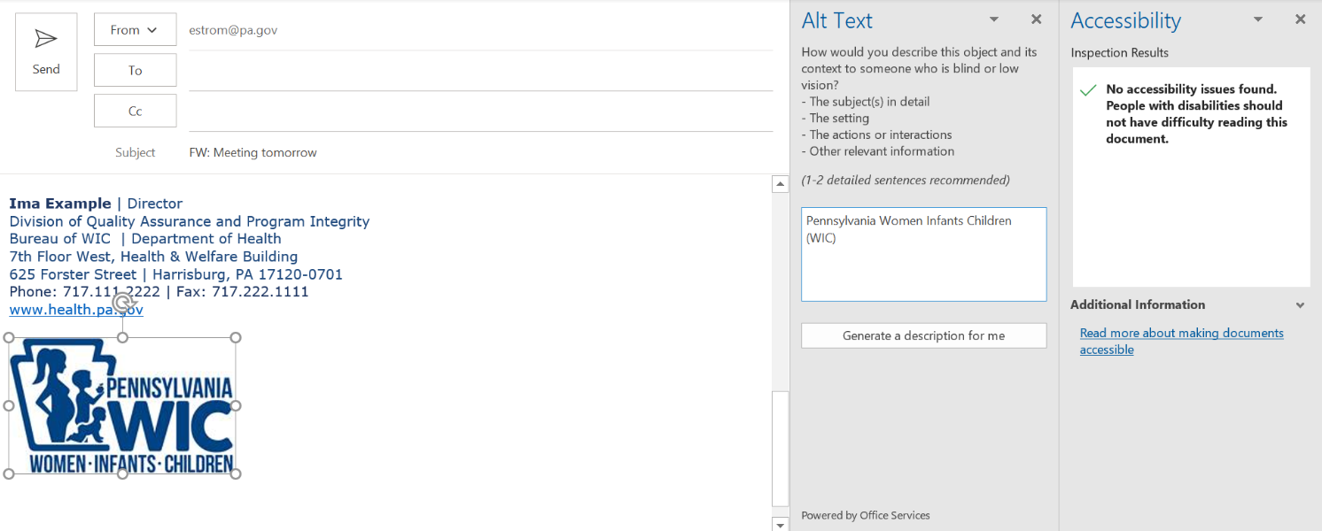
Email Example 1: Add description
Once you add the description, the error message disappears.
Notes:
Best practice says, you enter the specific words in the image.
You can also add: a description of the woman, child and infant surrounded by the keystone.
Plus, you still see other options like:
Generate a description for me
And additional information about making documents accessible.

Slide 7
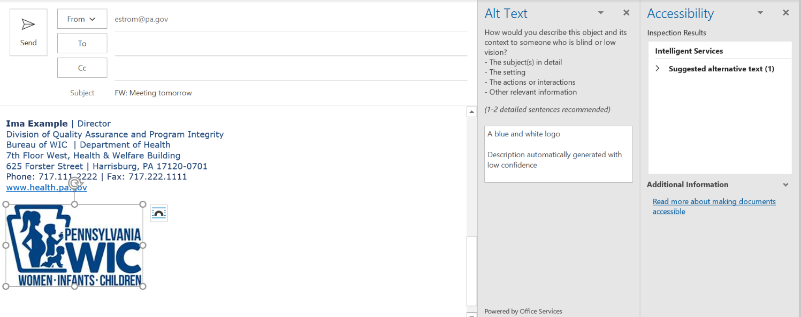
Email Example 1: Auto-generated description
Auto-generated descriptions must always be reviewed. You can see from this example that the description isn’t very accurate.
Notes:
For this example, when you select “generate a description for me, you see: “a blue and white logo. Description automatically generated with low confidence.”
While this description is correct, it isn’t very good from a branding perspective or general information perspective.

Slide 8
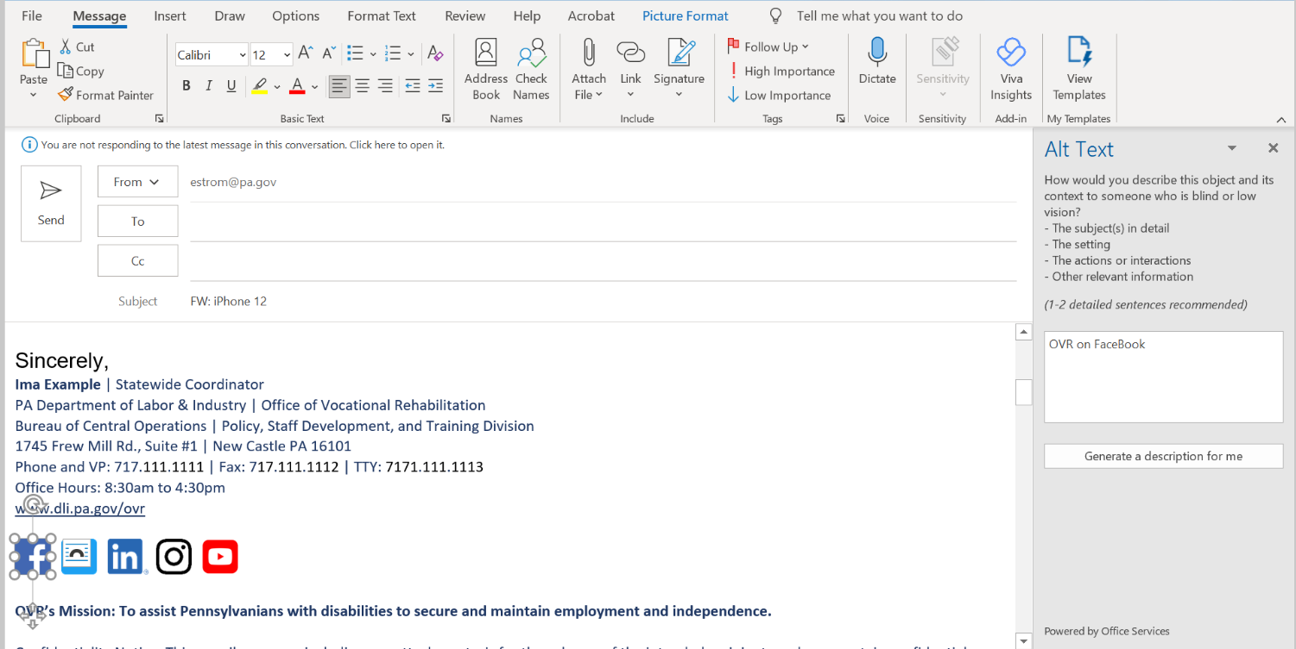
Email Example 2: Good alt text for Facebook
This alt text is a very clear description unless you don’t know what OVR is.
Notes:
If there’s a chance that people who receive your email don’t know what OVR stands for, then you should spell it out “Office of Vocational Rehabilitation (OVR).
While this example spells it out in the signature, it doesn’t follow it with (OVR) so people still may not understand what OVR stands for.
I didn’t take a screenshot of each, but each icon follows the same format:
OVR on Twitter
OVR on LinkedIn
OVR on Instagram
OVR on YouTube

Slide 9
Email Example 3: Message in an image
Notes:
From an employee engagement perspective, I thought this email was awesome!
Then, I went to forward it and found out when I ran the accessibility checker that it didn’t have an ALT text.
I talked to the organizer of the email and they used our email system and selected the option to include a text version of the email.
I didn’t’ get that text version.
The email system will be included in an upcoming project so we will figure out the appropriate settings at that time.

Slide 10
Email Example 3: Alt text for the Valentine message
Option 1:
#GOVLOVE. Roses are red, Violets are blue, The most important part of our work is you! Thanks for all you do to make the commonwealth a better place to live and work. We appreciate you. Happy Valentine's Day from your friends at OPE. Logo: Office of the Governor. Office of Performance through Excellence.
Option 2:
The message in Option 1, plus
A description of the image: A bluebird carrying an envelope sealed with a heart in its beak.
Notes:
Everybody is different in what they want to see in a message.
Some prefer option 1 which is just the text of the message.
Others prefer option 2 with the extended description.
Option 1 is considered minimum requirement.

Slide 11
Word Example: Add a Title

Slide 12
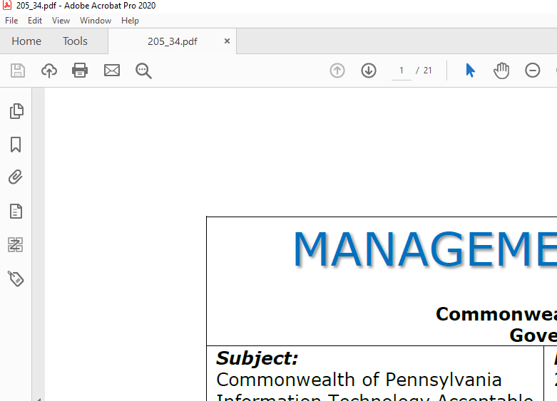
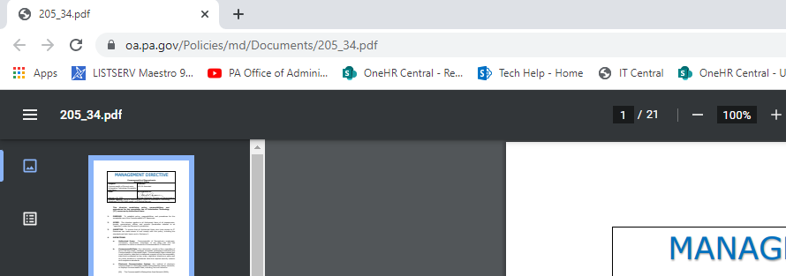
Title Example 1: Missing title in properties
When there is no Title information in the properties, the Title that displays in Acrobat and web browsers defaults to the file name, in this case is “205_34.pdf”
Correct title: Management Directive 205.34 – Commonwealth of Pennsylvania Information Technology and Acceptable Use Policy

Slide 13
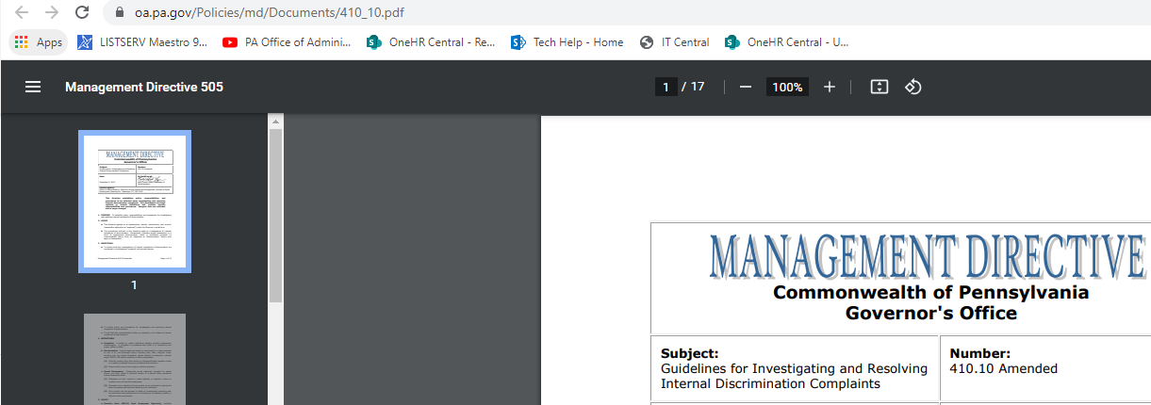
Title Example 2: Copy/paste error
Reusing a document “template” without updating Title property: Although this is MD 410.10, the title attribute says Management Directive 505.

Slide 14
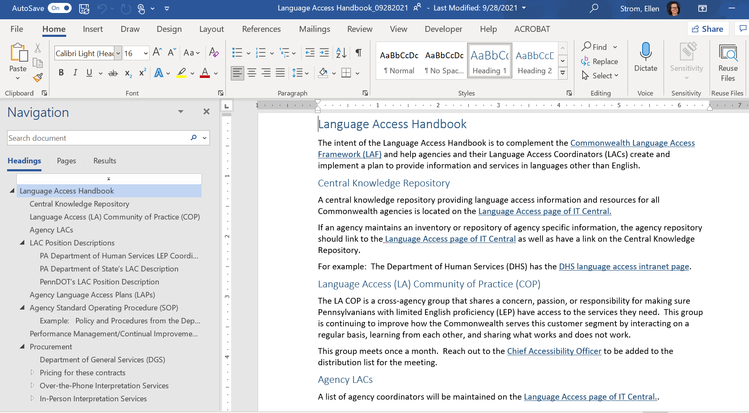
Word Example: Use Headings
Notes:
Use headings in your word documents.
You can easily navigate to each section.
You can easily create a table of contents.
Example of how using the right syntax helps everybody!

Slide 15
Word Example: Open the navigation panel
Notes:
In order to see the navigation pane, you need to go to the view tab in the ribbon and select the navigation pane checkbox.

Slide 16
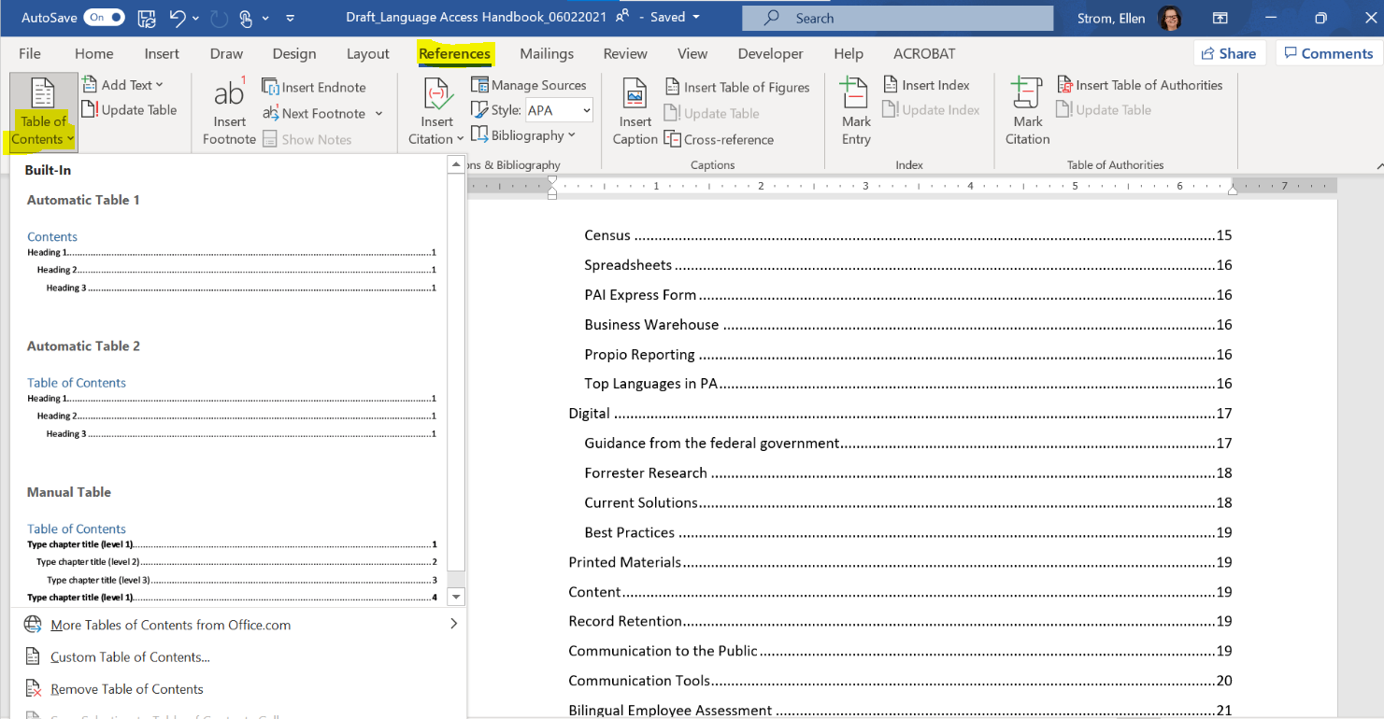
Word Example: Add a table of contents

Slide 17
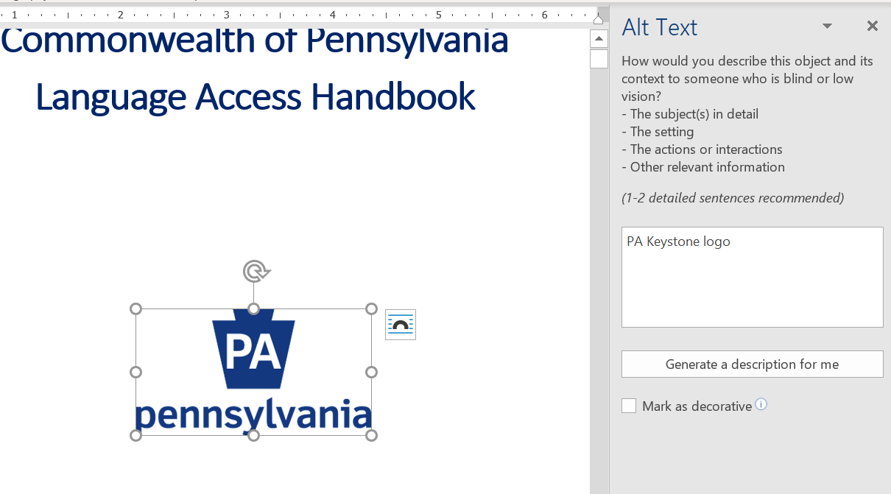
Word Example: Add alt text to an image
Notes:
You can add an alt text to a logo by right clicking on the mouse. The alt text input box will appear.
This alt text will be read by a screen reader as “P A Keystone logo.”
You could type out Pennsylvania for more clarity.
In this case, I would not try to explain the PA image and the spelled out Pennsylvania.

Slide 18
PowerPoint Example: Add a title
Notes:
As with word, the first step should be to add a title in the info tab in PowerPoint.

Slide 19
PowerPoint Example: Check reading order
Notes:
I find that the easiest way to check reading order is by selecting “arrange” on the home tab.
Then selection section pane.
The reading order in the selection pane goes from bottom to top.

Slide 20
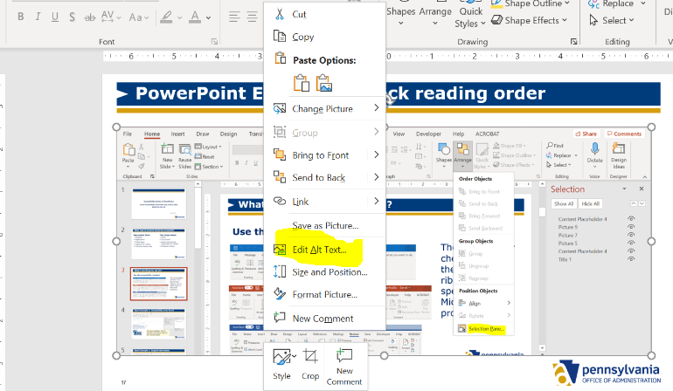
PowerPoint Example: Add alt text
You can also right click on the image to add alt text.
Notes:
Instead of waiting to add the alt text when you run the accessibility checker, you can right click the image after you add it.
You will get a popup menu where you select “edit alt text.”

Slide 21
Resources
Captions, Transcripts and Audio Description
Described and Captioned Media Program
FCC Closed Captioning Standards
3PlayMedia
Speech to text & Accessible Telecommunications
(Speech to text: Live captions, CART and transcripts. Accessible telecom: captioned phones, captioned apps, live captions in MS Teams and Zoom, etc.)
Russ Goddard, Statewide Coordinator of Deaf, Hard of Hearing, and DeafBlind Services
PA Department of Labor & Industry | Office of Vocational Rehabilitation
email: rgoddard@pa.gov
Notes:
There isn’t time to talk to all topics. These are some additional resources that I thought you might find useful.

Slide 22
Contact
Ellen Strom
Chief Accessibility Officer
PA Office of Administration
Office for Information Technology
Accessibility Center of Excellence
Email: RA-OAAccessibility@pa.gov
Notes:
These are all things that you can start doing in order to make sure that everyone can read your email or access your documents.
Do you have questions?
Do you have suggestions on other things that people can do?

