Slide 1
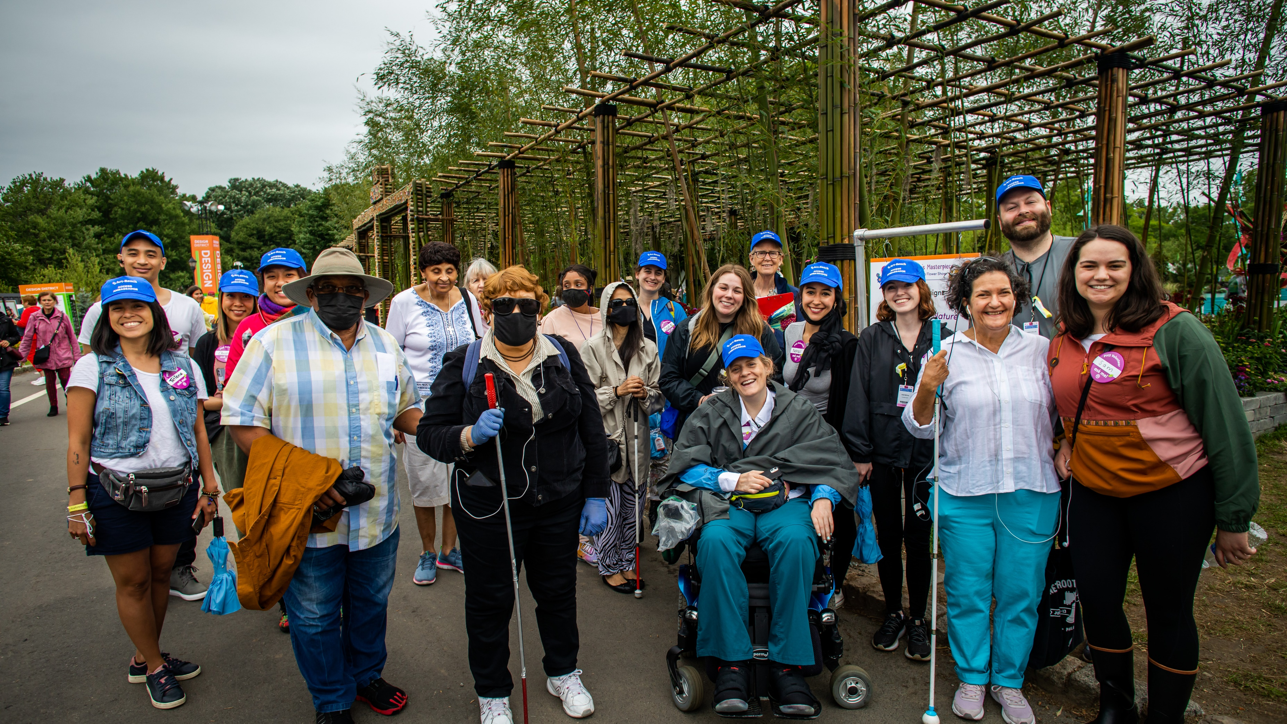
Art-Reach creates, advocates for and expands accessible opportunities so the full spectrum of society is served.
Photo Credit: Ashley Smith/ Wide Eyed Studio
Notes:
So happy to bring you this introductory training as part of our re-envisioning our program team at Art-Reach to bring more professional development, training and learning opportunities to the arts and cultural sector both in the Greater Philadelphia region and all over the country.

Slide 2
Pandemic Response
How do we make the arts accessible when people are experiencing everything virtually?
CAPTIONS!!!
Embed Audio Description
Sensory Friendly Activities
Notes:
Roger Ideishi (2020) Sensory Friendly / Relaxed Performances: Knowledge, Skills, and Capacity. Online Webinar.

Slide 3
ENCORE at Home Videos: https://youtube.com/playlist?list=PLGqOyUss8PQbRhEdy89r4oPdiHVgRv55K

Slide 4
Questions?

