Slide 1
Using Analytics to Unravel Complex Social Issues
Jennifer Robinson
SAS

Slide 2
Steps to Data-driven Decisions
Provide visualizations and reports
Employ analytics
Define a business problem
Establish data governance
Survey data and inventory data
Perform data integration
Create a shared vision

Slide 3

Decision-Making Spectrum
What is the best outcome?
Optimization
Predictive
Modeling
Forecasting
Statistical
Analysis
ANALYTIC MATURITY
Alerting
Query
Drilldown
Ad Hoc
Query and
Reporting
Standard
Reporting
INFORMATIONAL
PROACTIVE
Notes:
Classic waterfall diagram

Slide 4
Decision-Making Spectrum
What is the best outcome?
Optimization
Predictive
Modeling
Forecasting
Statistical
Analysis
ANALYTIC MATURITY
Alerting
Which inmates should be matched with support services?
Query
Drilldown
Which inmates have been treated for addiction?
Ad Hoc
Query and
Reporting
How many male inmates have used EMS twice in six months?
Standard
Reporting
How many people without homes are incarcerated each year?
INFORMATIONAL
PROACTIVE
Notes:
Classic waterfall diagram

Slide 5
Decision-Making Spectrum
What is the next best action for preventing incarceration of homeless males?
What is the best outcome?
Optimization
What impact could we expect from permanent housing and support services?
Predictive
Modeling
What is the financial impact of an increasing homelessness population on our jails?
Forecasting
Who is at risk of recidivism?
Statistical
Analysis
ANALYTIC MATURITY
Alerting
Which inmates should be matched with support services?
Query
Drilldown
Which inmates have been treated for addiction?
Ad Hoc
Query and
Reporting
How many male inmates have used EMS twice in six months?
Standard
Reporting
How many people without homes are incarcerated each year?
INFORMATIONAL
PROACTIVE
Notes:
Classic waterfall diagram

Slide 6

Unraveling homelessness
Provide vulnerable people with the right services
Problem
Demand for mental health and substance abuse treatment, care coordination services, and supportive housing far outstrips the supply.
A highly vulnerable segment of the population repeatedly cycles through local jails, emergency departments, homeless shelters and other public systems.
Objectives
Provide decision makers insight into the current status of homelessness in their jurisdictions
Utilize data and analytics to assess different facets of the situation
Leverage data and analytics to make best decisions
Challenges
A large number of entities, government and non-profit, provide services to this population (housing authorities, health services, law enforcement, etc.)
Obtaining clean data and matching clients across service providers is very difficult

Slide 7
Unraveling homelessness
Approach for utilizing analytics
Understand
Evaluate
Action
What is the profile of high utilizers of hospitals and jails?
What are key factors that correlate with high utilizers?
What support services can stop the cycle of high utilization?
How can support services be delivered to targeted population?
Are the shelters and housing adequate and in the right place?
What locations should additional resources go to?
How to bend cost curve for top utilizers of services?
How to prevent homelessness for vulnerable subpopulations?

Slide 8
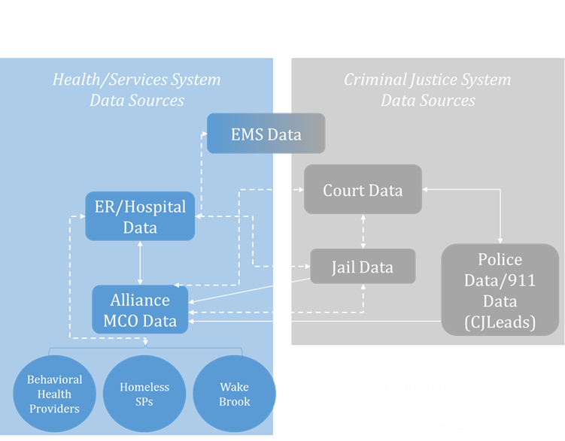
Unraveling homelessness

Slide 9
Unraveling Homelessness
Phase 1
Create a shared vision for addressing high utilization of services
Identify challenges and the scope of phases
Survey jail, homeless, and EMS data
Perform data integration
Analyze high utilizer population
Create and validate initial scoring model
Create report
Notes:
Phase 1
• Evaluate of data quality, content and consistency
• Integrate jail, Emergency Room or EMS
• Analyze high utilizer population
• Create and validate initial scoring model
• Create report

Slide 10

Unraveling Homelessness
Data is the foundation of analytics
SAS® Analytics
SAS® Data Management Layer
Homeless Data
Homeless Services Data
Social/Health Services Data
Pre-conviction Criminal Justice Data
Post-conviction Criminal Justice Data
Homeless Counts
Shelter Services Data
Social Services Benefits
911 Data
Incarceration History
HMIS Data
Subsidized Housing Data
Mental Health Services
Social Services Benefits
Court Record History
Individual Characteristics
Supportive Services Data
Emergency Room Services or EMS
Mental Health Benefits
Arrest Record History
Imprisonment History
Emergency Room Services
Incarceration History
Parole History
EMS Records

Slide 11
Unraveling Homelessness
Phase 2
Integrate additional data sources from hospitals, police and courts
Expand analysis of key factors
Analyze short, medium and long term outcomes
Track and monitor measures of success
Put analysis into operation for real-time understanding of utilizers
Use findings to drive policies, programs, and budgeting decisions
Notes:
Phase 1
• Evaluate of data quality, content and consistency
• Integrate jail, Emergency Room or EMS
• Analyze high utilizer population
• Create and validate initial scoring model
• Create report

Slide 12
Unraveling Homelessness
Data is the foundation of analytics
SAS® Analytics
SAS® Data Management Layer
Homeless Data
Homeless Services Data
Social/Health Services Data
Pre-conviction Criminal Justice Data
Post-conviction Criminal Justice Data
Homeless Counts
Shelter Services Data
Social Services Benefits
911 Data
Incarceration History
HMIS Data
Subsidized Housing Data
Mental Health Services
Social Services Benefits
Court Record History
Individual Characteristics
Supportive Services Data
Emergency Room Services or EMS
Mental Health Benefits
Arrest Record History
Imprisonment History
Emergency Room Services
Incarceration History
Parole History
EMS Records

Slide 13

Unraveling child abuse
Identify who is most at risk - at the right time
Intake Screening – assess risk based on initial reports
Provide risk scores
Create networks and timelines
Resolve entity issues
Ongoing case management – alerts generated on open CPS cases
Generate automated alerts for open cases
Surface ancillary data relevant to cases
Gain insight from complex data

Slide 14
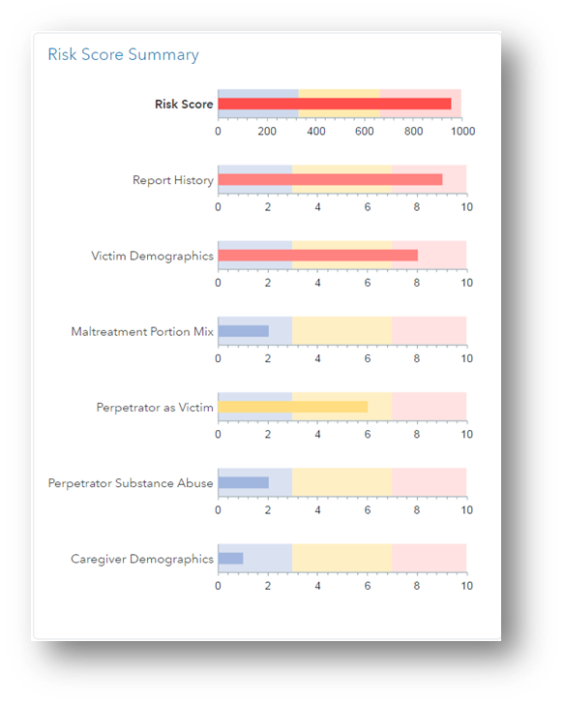
Unraveling child abuse
A caseworker can be confronted with a huge volume of information.
Translate information from disparate data sources into a risk score summary.

Slide 15
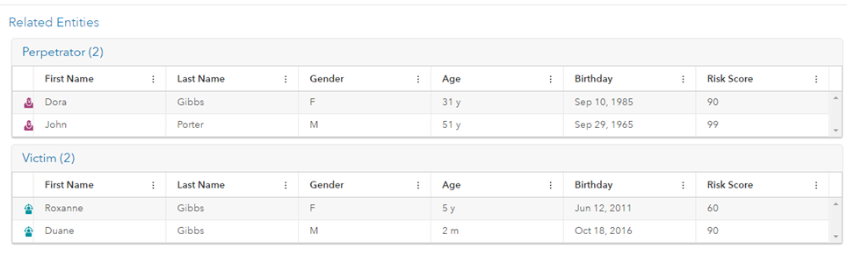
Unraveling child abuse
A caseworker can be confronted with a huge volume of information.
Translate information from disparate data sources into a risk score summary.

Slide 16
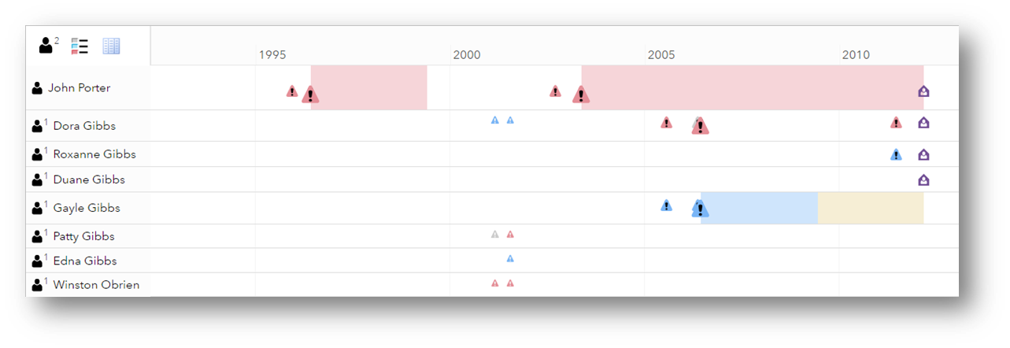
Unraveling child abuse
Summarize years of CPS events for individuals related to a case.

Slide 17
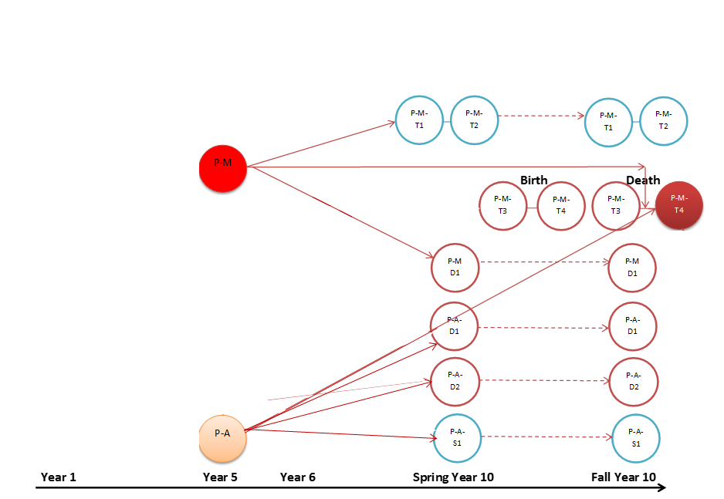
Unraveling child abuse
Relationship map without entity resolution

Slide 18
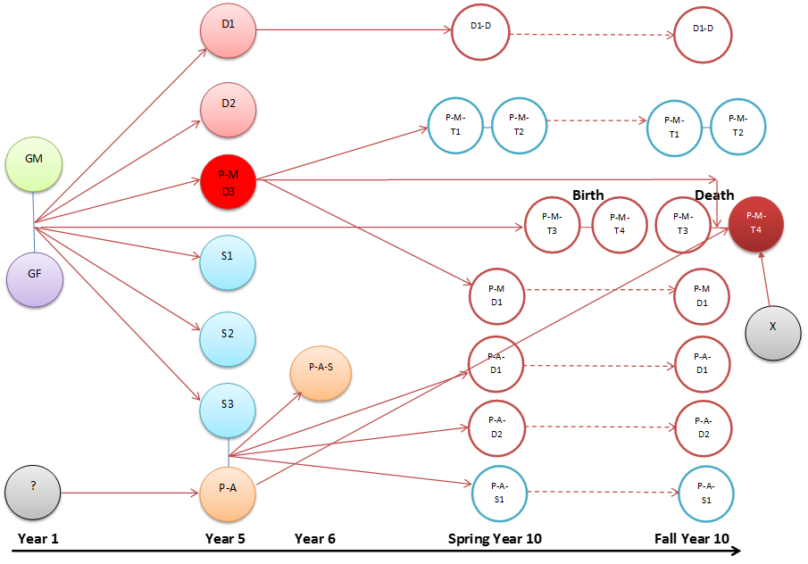
Unraveling child abuse
Relationship map with entity resolution

Slide 19
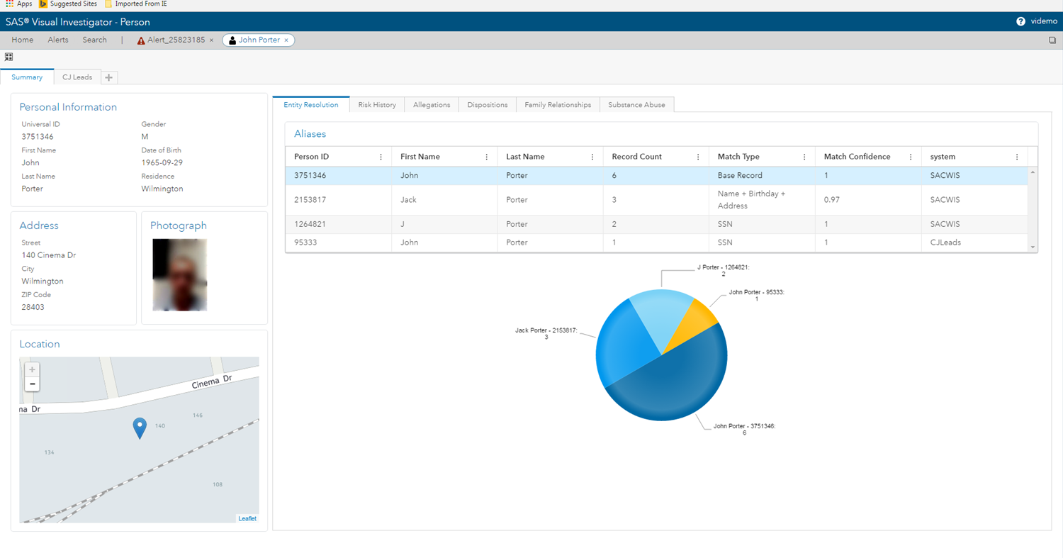
Unraveling child abuse
Many systems suffer from data gaps caused by individuals with multiple IDs within and between CPS jurisdictions.
The Visual Investigator tool resolves these gaps to yield a more complete report history for alleged perpetrators and victims.

Slide 20
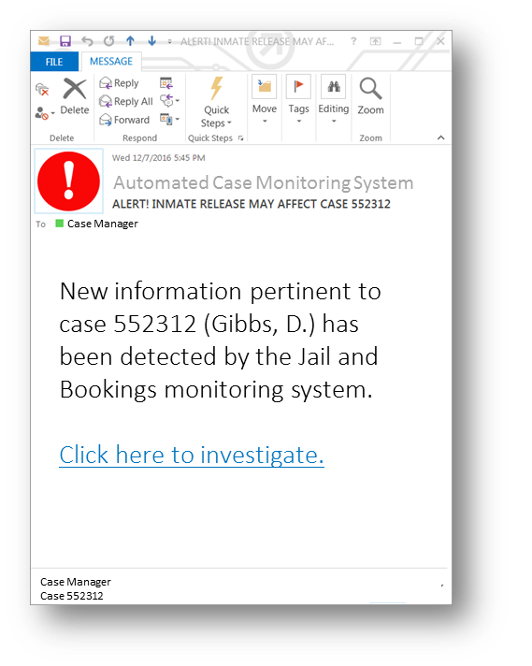
Unraveling child abuse
New information changes the risk score.
Therefore, alerts are sent to case workers when new information pertinent to a case becomes available.

Slide 21

Unraveling opiate abuse
Identify prescribers, dispensers, and patients
Prescribers
Which prescribers have suspicious or unusual behavior patterns that warrant further investigation?
What are the common characteristics of prescribers who engage in inappropriate and/or unlawful prescribing patterns?
Dispensers
Which dispensers are not reporting filled prescriptions accurately and/or timely?
Which dispensers may be viewing patient prescription records inappropriately?
Patients
Which patients have suspicious or unusual prescription patterns that warrant further investigation or intervention?
Which patients may be intentionally misrepresenting identity and/or the victims of identity theft, undertaken for the purpose of obtaining controlled substances inappropriately?

Slide 22
Unraveling opiate abuse
Data Collection
Allows reporters to report prescription data on a daily basis
Employs data from numerous external sources
Robust identity resolution using probabilistic matching
Analytics
Continuous analytics to produce alerts and external reporting daily
Enables advanced geospatial analysis
Uses advanced analytics to detect emerging schemes and hard-to-find behaviors
Workload Management
Provides alert triage for automated workflow
Automated external Reporting

Slide 23
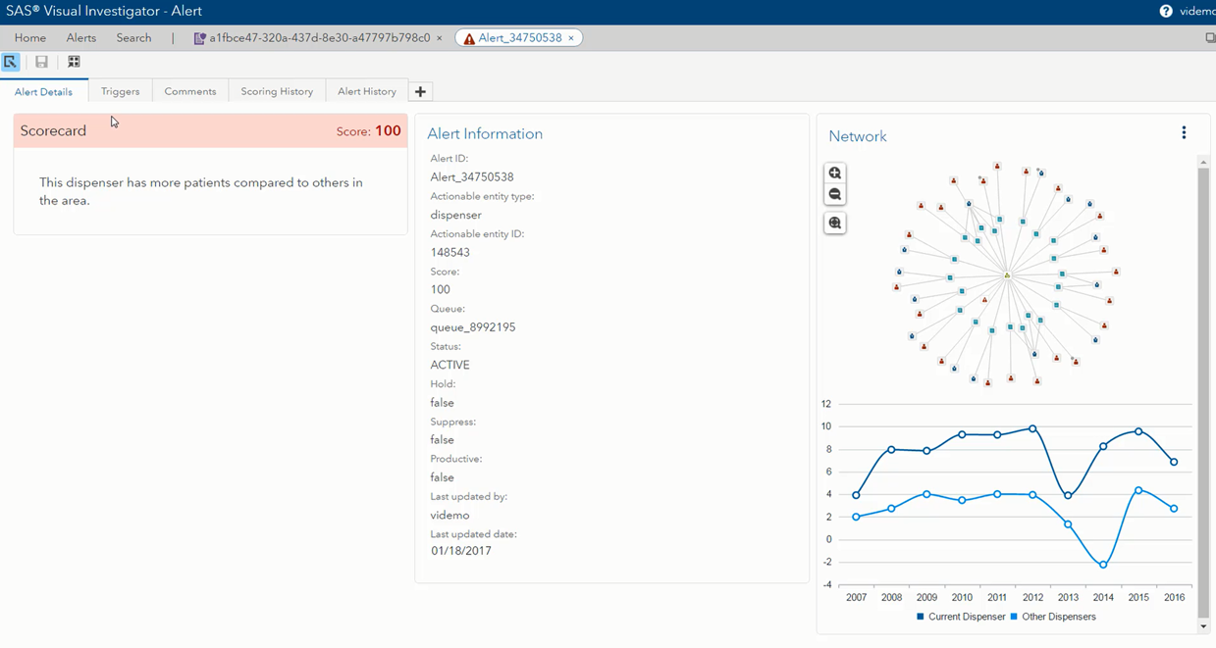
Unraveling opiate abuse
Alert scoring with comparison to dispenser peer groups within a compressed network.

Slide 24
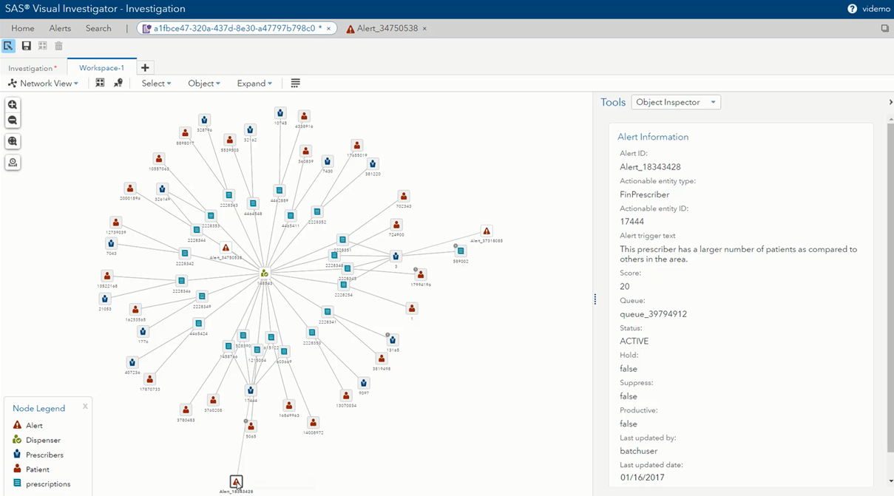
Unraveling opiate abuse
Alert scoring with comparison to dispenser peer groups within a compressed network.

Slide 25
Unraveling opiate abuse
Alert scoring with comparison to dispenser peer groups within a compressed network.

Slide 26

Unraveling Student Success
Assist teachers and students to achieve their best
Growth models based on reflective and forward looking analytics
Educators
How much have teachers/schools/districts influenced student growth in the past?
Students
How likely are students to be successful in the future?
Forward-Looking
Student Projections
Reflective
Student Growth Metrics

Slide 27
Unraveling Student Success
Assist teachers and students to achieve their best
Elements
Growth models based on reflective and forward looking analytics
Accurate linkages between teachers and students to attribute the amount of growth a student has experienced with each teacher
Results as a service
Reports that dig into diagnostic information as well as customized reports so that administrators can explore data
Forward-Looking
Student Projections
Reflective
Student Growth Metrics

Slide 28
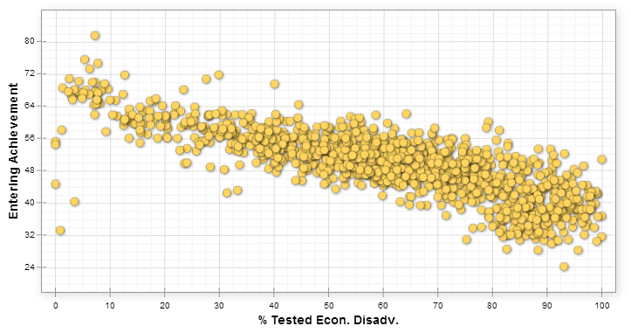
Correlation
Achievement and Poverty
Notes:
To further illustrate the difference between achievement and growth in one other way – let’s look at 2 scatterplots.
Each gold dot here represents a school in the state of Tennessee, and every school is included here.
There are 2 reasons why we are looking at this data out of Tennessee:
Tennessee is very similar to many states (urban/rural, English language learners, student mobility, etc.)
That data out of Tennessee is public
On the horizontal axis, schools are graphed based on the quantity or percent of students that they serve who come from economically disadvantaged backgrounds.
On the vertical axis, schools are graphed based on the entering achievement level of their students.
It is clear to see the correlation – schools that serve fewer students from economically disadvantaged background tend to have higher entering achievement levels than schools how serve more of these students.
This is essentially what we are talking about when we discuss the achievement gap. In terms of poverty, there is definitely a disparity in achievement. This disparity has real implications when trying to discuss such critical matters as school and teacher effectiveness if we were only to base that on achievement.
Now let’s look at these same schools in regard to academic progress…

Slide 29
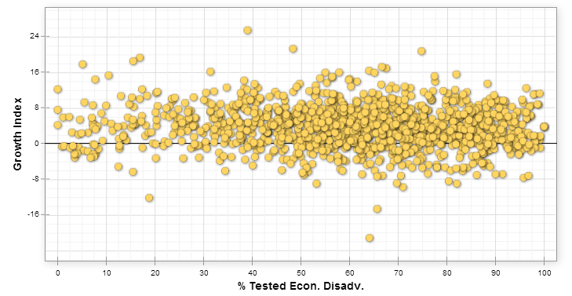
Correlation
Academic growth and Poverty
Notes:
These schools still serve the same students, but when looking at their data through the lens of PROGRESS or GROWTH, rather than achievement, it is clear to see that schools across the spectrum can and do make stellar growth with their students.

Slide 30
Using Data Differently
Be proactive vs. reactive
Identify and prioritize highest-impact issues
Combine data from many data sources to improve informed decision making
Seek actionable insights from data
Use data to inform meaningful policy, procedure, and practice.
If you
change the way
you look at things,
the things you look at
change.
- Wayne Dyer

Slide 31
Thank You
Questions? Jennifer.Robinson@sas.com

