Slide 1


Slide 2










Slide 3





200+ REGISTRATIONS
50+ CITY OFFICIALS
10 CORPORATE PARTNERS
11 SPEAKERS
26 REPRESENTATIVES FROM EDUCATION

Slide 5
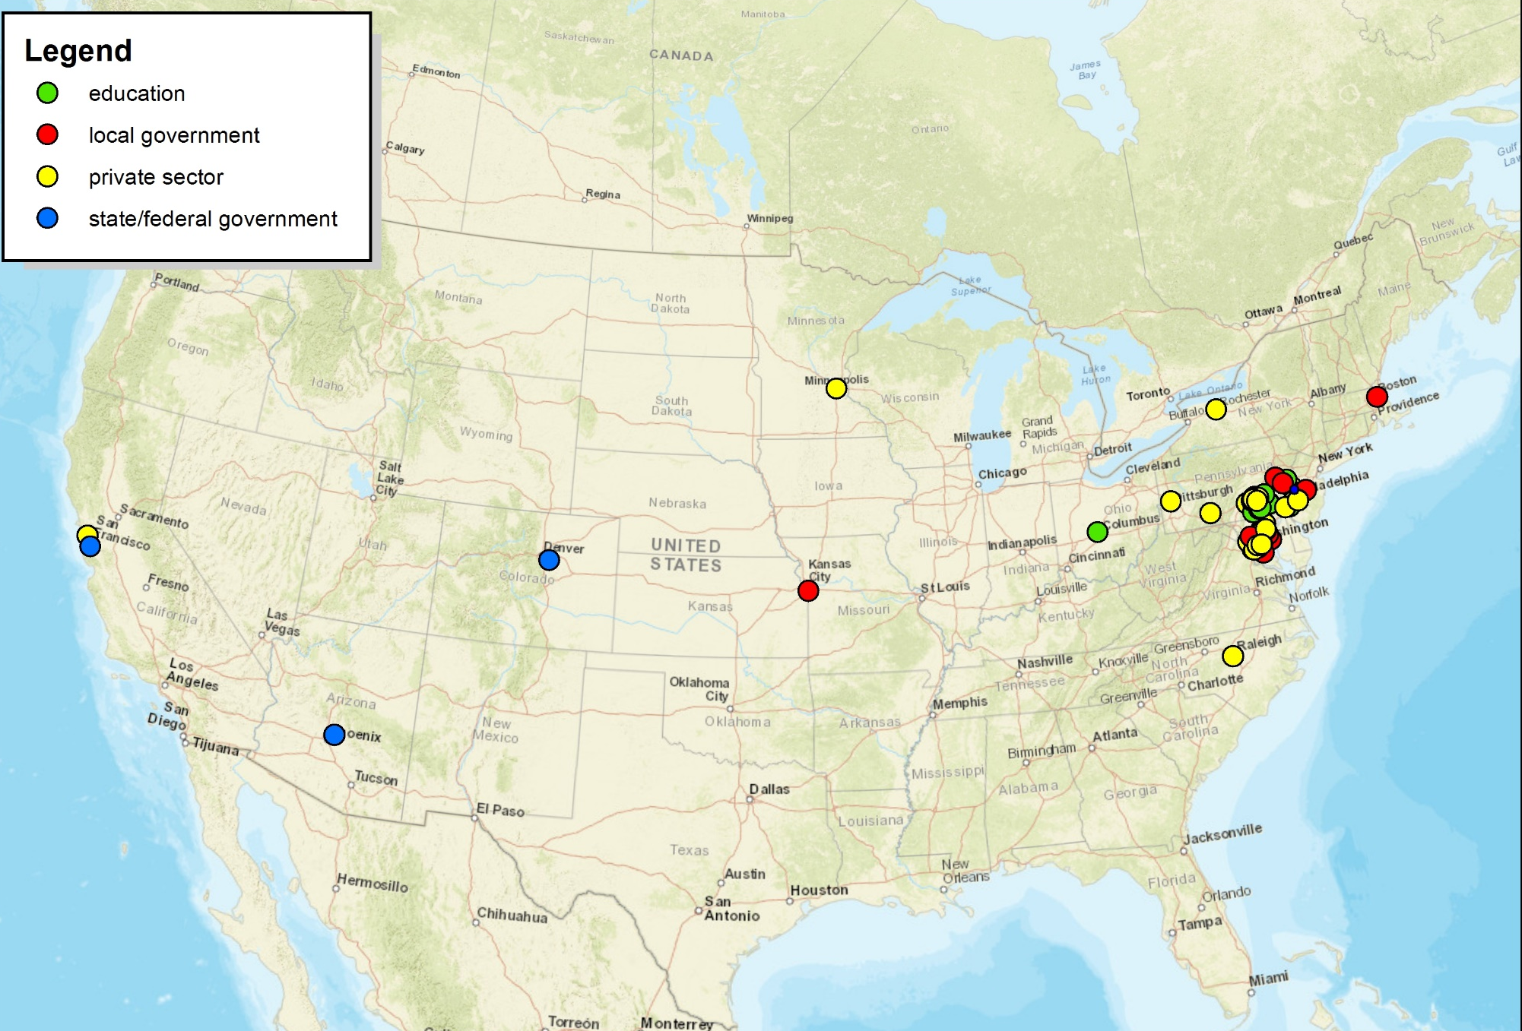
Registration by zip code (US)

Slide 6
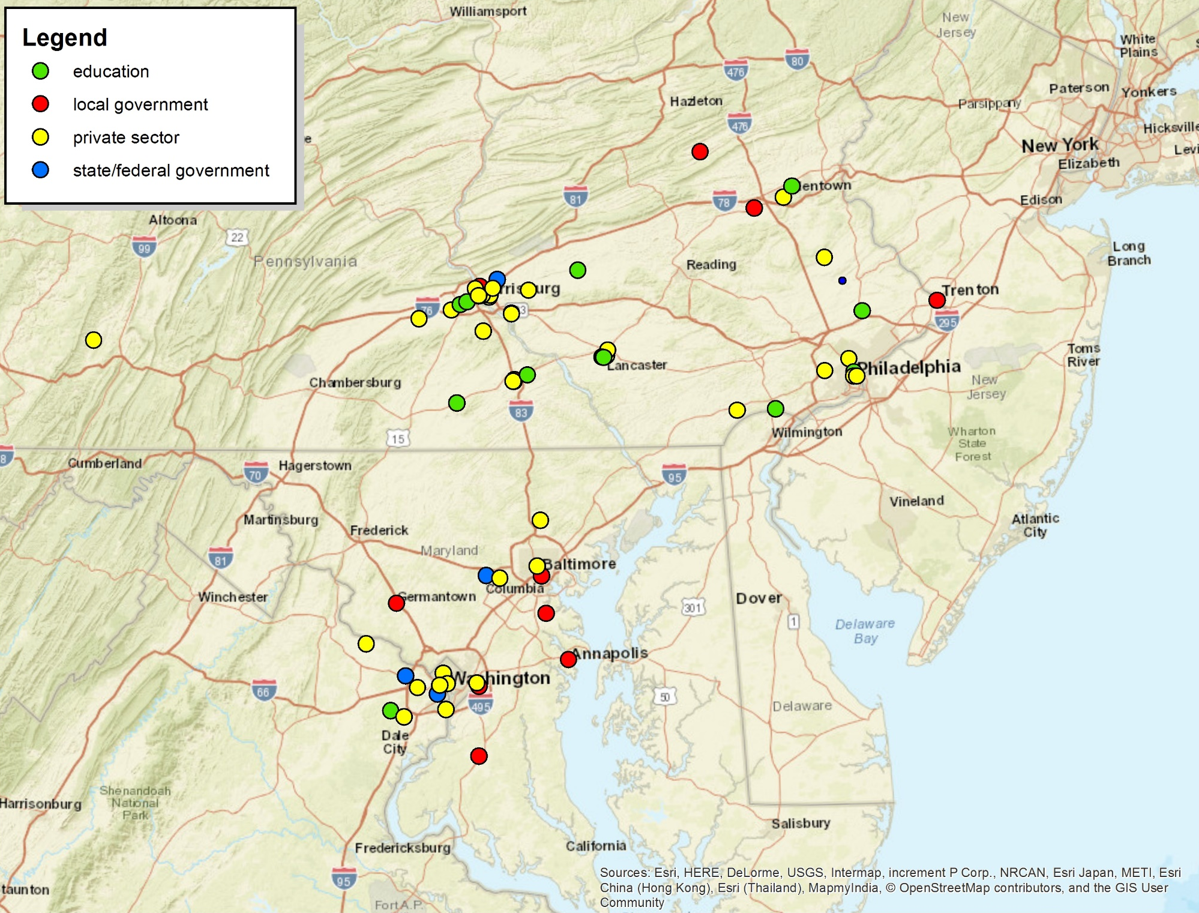
Registration by zip code (PA)

Slide 7

Harrisburg University of Science and Technology:
Centers & Institutes
Analytics Institute (AI)
Geospatial Technology Center (GTC)
The Government Technology Institute (GTI)
The Security Center of Excellence (SCE)
Center for Advanced Entertainment and Learning Technologies (CAELT)
The Agile Lean Center (ALC)

Slide 8


Save the Date!
Part I: Sept. 28th – Oct. 1st
Part II: Nov. 4th
Register now to stay updated: www.code4pa.tech

Slide 9


Slide 10

Agile Lean Summit
This summit will bring together industry leaders from around North America to close the gap between traditional project management and Agile Lean.

Slide 11
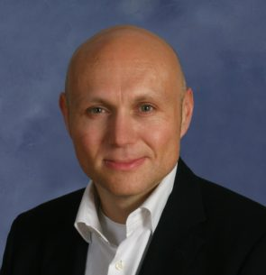
Agile Lean Summit
Sessions:
David West, Scrum.org:
“Managing Software Delivery in the Super Nova”

Slide 12

Agile Lean Summit
Sessions:
Ron Doyle, IBM:
“Agile, DevOps and Cloud”

Slide 13
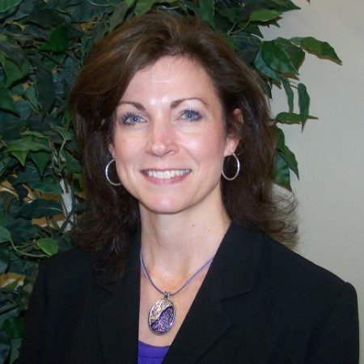
Agile Lean Summit
Sessions:
Suzette Johnson, Northrop Grumman:
“Commonalities of Agile and DevOps Transformation for Large Teams and Organizations”

Slide 14

Harrisburg University’s Government Technology Institute is the only one of its kind in Pennsylvania and a leader in harnessing technology to make good government great.
Programs:
Chief Information Officer (CIO) Certificate
IT Manager (ITM) Certificate

Slide 15

Government Technology Institute Sponsors

Slide 16
The Security Center of Excellence aims to be a strategic partner with public sector organizations in their information security and cyber defense efforts by providing innovative and effective educational programs and community building services.
Programs:
Chief Information Security Officer (CISO) Certificate

Slide 17

Security Center of Excellence Sponsors

Slide 18

Master of Science in Information Systems Engineering and Management (ISEM)
Graduate Program designed to educate the leaders who can plan, engineer and re-engineer, and manage the systems needed to support the modern digital enterprises.

Slide 19
Master of Science in Information Systems Engineering and Management (ISEM)
Courses:
ISEM 500 Strategic Information Systems Planning, Engineering & Management
ISEM 540 Architectures and Integration of Modern Enterprises
ISEM572 Strategic Intelligence and Smart Enterprises

Slide 20
Bachelor of Science in Analytics Program (ANLY)
Four-year degree designed for the student seeking a greater emphasis on studying informatics and business intelligence.

Slide 21
Informatics (HIMS) Certificate
Provides sophisticated analytics and data governance paired with essential communication and implementation skills such as Agile, Lean, Knowledge Management, Program Management and Change Management.

Slide 22
5 year BS-MS Analytics Program
Baccalaureate degree in Analytics, Computer and Information Sciences, or Interactive Media
Master’s degree in Analytics, Information Systems Engineering and Management, or Learning Technologies.

Slide 23
M.S. Degree in Analytics
All three areas of data analysis are studied: predictive (forecasting), descriptive (business intelligence and data mining), and prescriptive (optimization and simulation).

Slide 24
Ph.D. in Data Science
Get your Ph.D. in Data Science at Harrisburg University
Explore new ideas and do unique new research that pushes the boundary of human knowledge
By 2018 there will be 150,000 to 200,000 openings for data scientists and data analysts that would go unfilled
HU’s doctoral program launches in September 2017
Email CONNECT@HarrisburgU.edu to learn more

Slide 25
Ph.D. in Data Science
Join Harrisburg University as an Instructor, Mentor or Student
Doctoral program in data science launching September 2017
Developed in partnership with businesses
Email CONNECT@HarrisburgU.edu to learn more

Slide 26
Geospatial Technology Center (GTC)
  Hands-on (PAID) experience through grants, client based projects and subcontracted positions
  Off Site GIS Lab:
    PA DEP - Abandoned Mine Mapping Grant
    PA American Water – Staff Augmentation
    Tri-County Regional Planning Commission – Anderson Land Use Classification update

Slide 27
Geospatial Technology Program
  Unique blend of Geospatial Technology, Application Development and Database Administration
  Focused on Experiential learning: as many as 3,000 hours by graduation
  Highly applied: Students are encouraged to work with external partners as much as possible

Slide 28
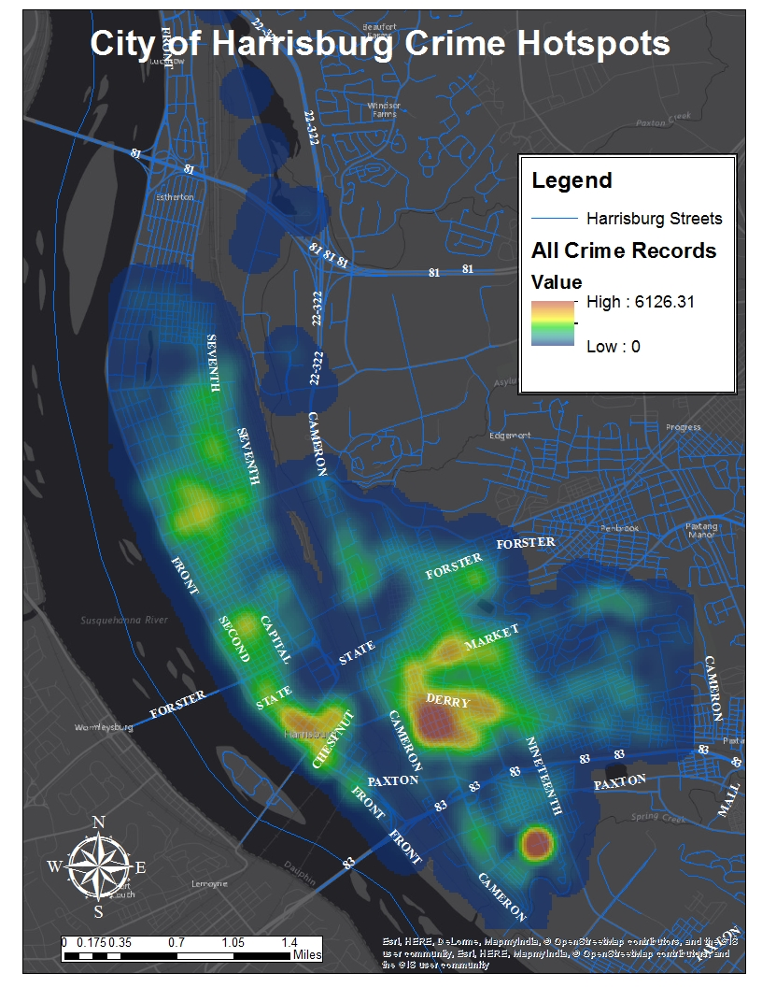
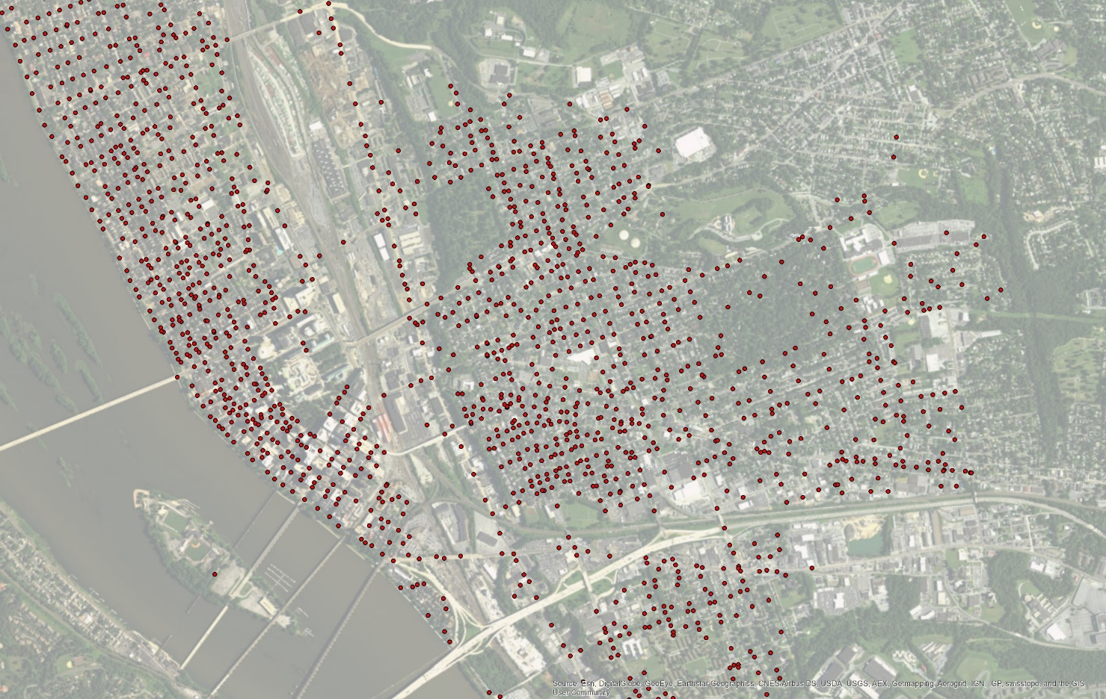
Types of Spatial Analysis

Slide 29
Geospatial Technology Internships
  9 credits of experiential learning. Project 1 & 2 as well as traditional internships
    City of Harrisburg, Dauphin County, PA DCNR, PennDOT, TCRPC, PA Downtown Center, National Geospatial Intelligence Agency, Lower Allen Township, Capitol Area Transit, New Oxford Water Company, Skelly and Loy, etc.

Slide 30

Working at Harrisburg University
Harrisburg University has open positions within our Data Analytics degree Programs!
Full-Time Faculty Positions
Corporate Faculty Positions
For more info: contact Erin Hill @ 717-901-5130 or ehill@harrisburgu.edu

Slide 31
Job Openings – Faculty Needed with Strengths In:
Management
eBusiness Strategy
Business Analysis & Design
Information Systems & Systems Engineering
Entrepreneurship

Slide 32
Working at HU: Corporate Faculty
Join our Data Analytics Corporate Faculty!!
Retain an industry position while enriching students’ minds by teaching an Analytics course every semester or two
For more info: contact Erin Hill @ 717-901-5130 or ehill@harrisburgu.edu

Slide 33
Working at HU: MEBA Degree Faculty
Join our Management & eBusiness (MEBA) Degree Program!!
Teaching strengths in the following areas are welcome:
Unstructured Data Analysis
Machine Learning
Data Algorithms
For more info: contact Erin Hill
@ 717-901-5130 or ehill@harrisburgu.edu

Slide 34
Working at HU: Project Management Faculty
Join our Project Management Graduate Degree Program!!
Teaching strengths in the following areas are welcome:
Fundamentals of Project Management
Agile Project Management
Contracting
Risk / Quality Management
For more info: contact Erin Hill @ 717-901-5130 or ehill@harrisburgu.edu

